Slide 1
Sustainable development indicators for Belgium Where do we stand on the way to the SDGs ?
MERI-BELSPO conference, April 25,2024
Alain Henry
Task Force Sustainable Devlopment, Federal Planning Bureau

Slide 2
United Nations – Sustainable Development Goals
Transforming our world: the 2030 Agenda for Sustainable Development (UN, 2015)
The Goals and targets will be followed up and reviewed using a set of global indicators. These will be complemented by indicators at the regional and national levels which will be developed by Member States (UN, 2015, §75)
FPB activities on SDG indicators fall within the scope of
Interfederal Statistical Institute – working group on SDG indicators
Institute for National Accounts – Beyong GDP indicators

Slide 3
SDG indicators – organisation & planning
The Interfederal Statistical Institute (ISI) defined lists of SDG indicators for Belgium
Based on UN global indicators, Eurostat indicators and previous FPB works
2023: a set of 82 indicateurs
Published on www.indicators.be by the FPB
Used in the second National Voluntary Review (July 2023, UN HLPF)
Q1 2023: lists of indicators at the heart of a debate with federal administrations and Advisory Councils
Starting from the 82 indicators: 10 to remove, 12 new, 4 to redefine
Plus 23 indicators to be developped by relevant administrations, with 9 priority indicators
2024: 78 indicators (2 new, 6 removed, 2 redefined)
2025: 84 indicators

Slide 4
Changes in the 2024 report
New indicators
Child poverty (i02)
Digital skills (i25)
New definitions
Capital stock (i45) / Physical capital stock
Raw material consumption (i55) / Domestic material consumption
Removed indicators
Life expectancy – included in Healthy life years (i12)
Depression – included in Mental disorders (i17)
Household consumption (no objective)
Gross investment in the physical capital stock (no objective)
Knowledge capital stock – included in Capital stock (i45)
Net external position (no objective)

Slide 5
How to measure progress towards the SDG?
Using indicators
Extrapolation of current trends: does it reach the target in 2030?
Using existing BAU scenarios (FPB, NECP, …)
Or extrapolating a trend
If no target, does it goes in the right direction (over 2000-2022 period)?
Premature deaths due to chronic diseases
?
?
SDG
?

Slide 6
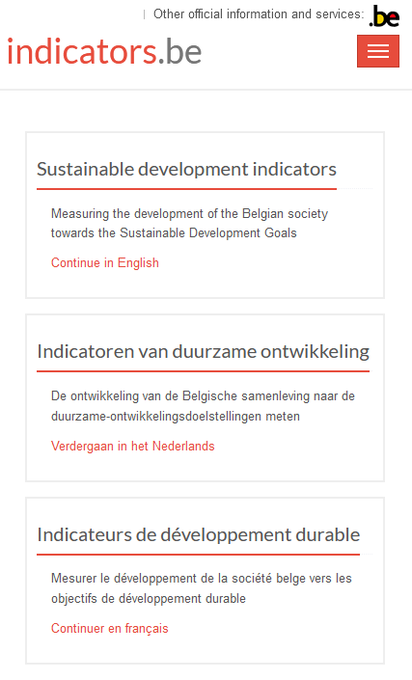
indicators.be – Sustainable Development Indicators
indicators.be // annual update
◆ Detailed information on indicators i01 - i78
◆ data = charts & data tables, from 1990 onwards
◆ description = definitions, objectives, breakdowns (more in NL & FR)
◆ download of text and data per indicator
◆ links to UN SDG, sources, institutions…
◆ assessment = assessing trends towards objectives

Slide 7
SDG in Belgium – 51 progress indicators
Assessment |  | Component |  |  |  | Total
 |  | Social | Environmental | Economic | Governance
With a target | Favourable | 2 | 4 | 1 | 0 | 7
 | Undetermined | 10 | 4 | 3 | 2 | 19
 | Unfavourable | 0 | 0 | 0 | 0 | 0
Desired direction (no target) | Favourable | 4 | 4 | 0 | 1 | 9
 | Undetermined | 0 | 1 | 1 | 0 | 2
 | Unfavourable | 7 | 3 | 2 | 2 | 14
Based on available date on octobre 31, 2023

Slide 8
Changes between February 2023 / February 2024
Smokers – i21 | New target (stratégie interfédérale pour une génération sans tabac) | de | à
Exposure to particulate matter – i52 | Strenghtened target, from 10 to 5 µg/m³ (OMS) | de | à
Natura 2000 protected land area – i66 | New target (2030 Objectives from COP Biodiversity 2022) | de | à
Raw materials consumption – i55 | New indicators (replaces Domestic material consumption) | de | à
Victims of natural hazards – i61 | Target 2020-30 is already exceeded (number of people affected by 2021 floodings) | de | à
Forests with FSC or PEFC label – i67 | Indicator decreased in the last 2 years | de | à

Slide 9
Belgium in the EU – ranking for latest year
Overview of most recent year in 68 charts
BE compared to EU countries, EU average and 3 neighbours (DE, FR, NL)
Average results | example: 59 indicators compared to other EU countries (in 3 groups)
BE 22 times in top third example: Natura 2000 protected marine area (i65) 23 middle third Underachievement in reading (i26) 14 bottom third Employment rate (i40)

Slide 10
Belgium in the EU per SD component
Number of indicators (total = 59) | most recent year
BE compared to EU | Component |  |  |  | Total
 | Social | Environ-mental | Economic | Governance
Top third | 13 | 2 | 4 | 3 | 22
Middle third | 15 | 5 | 3 | 0 | 23
Bottom third | 3 | 7 | 4 | 0 | 14
Total | 31 | 14 | 11 | 3 | 59
!
BE scores better
Do not confuse international comparison & trend assessment towards SDG
BE scores worse

Slide 11
42 indicators broken down by Region
Overview in 42 charts: BE and three regions, 2015-2022
Descriptive approach
Ranking of regions very stable over 2015-2022
26 indicators with no changes in ranking
4 indicators with only 1 year of data
7 indicators with one change for only one year
5 indicators with more changes in the ranking
Evolution of regions over 2015-2022
18 indicators: all regions move in the desired direction (towards the objective)
5 indicators: all regions move in the undesired direction
14 indicators: various directions
5 indicators: without changes

Slide 12
Breakdown across various categories of population
"Leave No One Behind" = "we wish to see the Goals and targets met for all nations and peoples and for all segments of society. And we will endeavour to reach the furthest behind first." (2030 Agenda, §4)
Women / men (38 indicators)
No difference: Life Satisfaction (i20) and Dwellings without adequate heating (i34)
Worst situation: 19 for women and 17 for men
Biggest differences against women: Postponement or cancellation of health care for financial reasons (i07) and Security feeling in public spaces (i73)
Biggest differences against men: Road deaths (i20) and Fatal accidents at work (i42)
Other breakdowns: age (16), income (20), education (11), household type (6), …

Slide 13
Many differences are stable over time, except
Guaranteed minimum income beneficiaries (i05): share of beneficiaries aged 18-24 has more than doubled
Mental disorders (i17): differences by income level have increased
Higher education graduates (i24): share of men (25-34 years old) increases more slowly than the share of women
Long-term work incapacity (i38): rapid increase for
people between 50 and 64
women

Slide 14
Conclusions
Cooperation with all Belgian actors
With unchanged policies, few SDGs would be reached in 2030
Need of more quantitative objectives for a more accurate assessment of the trends towards the SDGs
Useful to zoom on specific categories of population

Slide 15
Thank you
More information
www.plan.be
www.indicators.be
Questions
Patricia Delbaere – dp@plan.be
Alain Henry – ah@plan.be

Slide 16
Sustainable development indicators for Belgium Where do we stand on the way to the SDG’s ?
MERI-BELSPO conference, April 25,2024
Alain Henry
Task Force Sustainable Devlopment, Federal Planning Bureau

