Slide 1
Digital Wellbeing Strumbling (or not) over wireless internet
Prof. Dr. Elfi Baillien
Research Group Work and Organisation Studies
MERI – BELSPO, 25th of April 2024, Museum of Art and History, Brussels

Slide 2
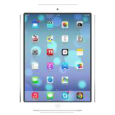
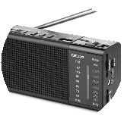
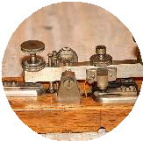
Work 4.0
Digital technologies
(1990-current)
ICT and www
=
“the most radical change in the labour market since the first industrial revolution” (De Vos, 2018)
Satellite-based technologies
(1960-current)
Information & Communication Technology (ICT):
All devices and technological platforms intended for
manipulation, storage, and dissemination of information.
Ex. telephone, mobile phone, computer, internet, e-mail, chats, collaboration platforms (Zoom, Teams), …
Television
(1950-current)
Radio
(1920-current)
Telephone (1870-current)
Telegraphy (1830-1920)

Slide 3
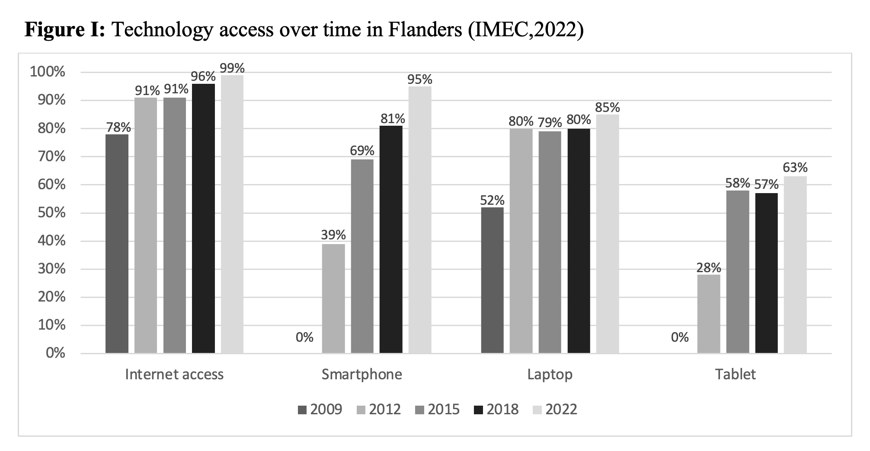
Digitalisation of work
Global internet usage: 15.6% (2005) -> 67% (2023) (ITU, 2023)
Europe: 91%
42% European employees spend at least half of their workday behaind a computer (Eurostat, 2023)

Slide 4
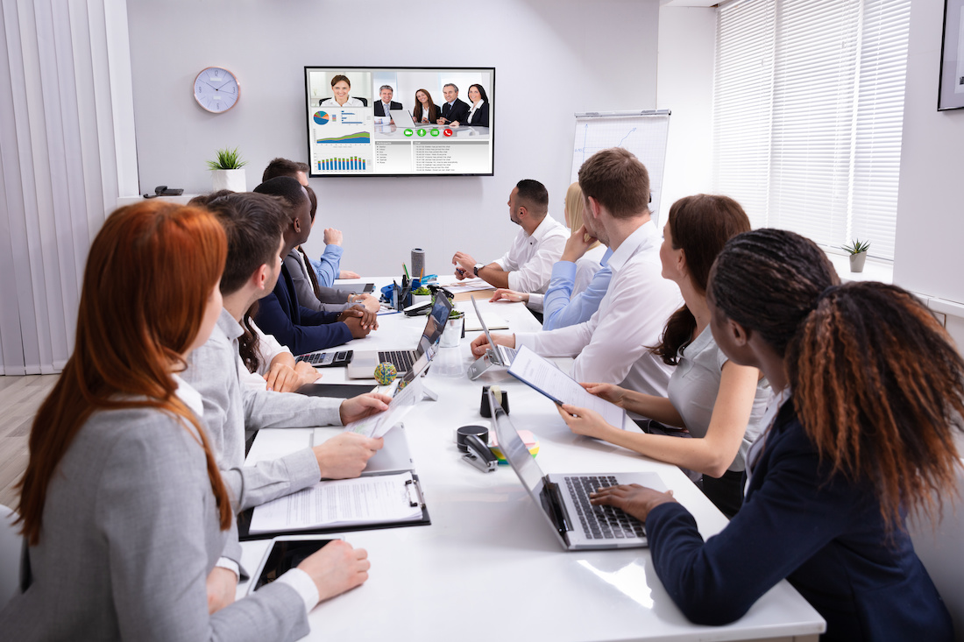

Slide 7
Work and ICT: the ambivalence

Slide 8
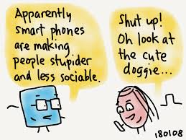
Paradox 1: Social connectivity
+
-
Lower quality interactions
Higer quantitity interactions
(Day, Barber & Tonet, 2012)

Slide 9
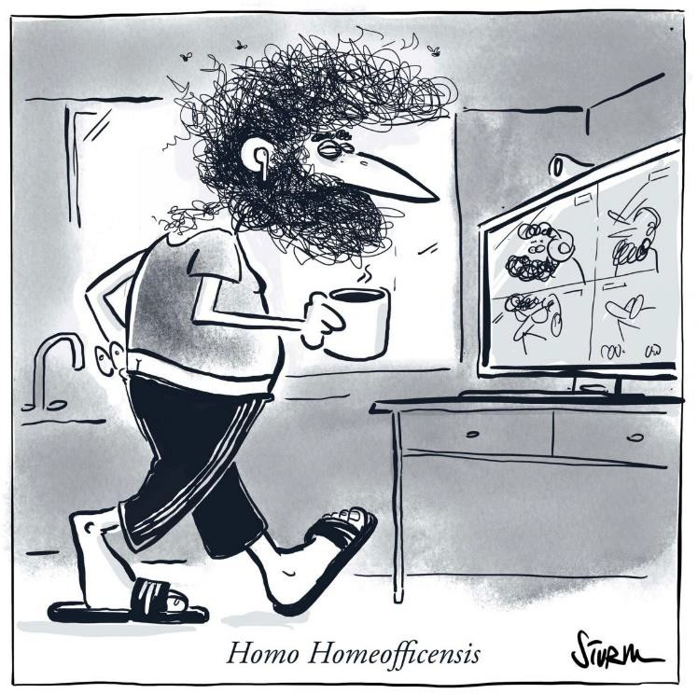
Instrumental
Expressive
Work role related relationships
Important for information and knowledge exchange
Informal, friendly relationships
Important for social and emotional support
May be promoted by online communication, e.g. through use of internal social media (Ali-Hassan et al., 2015)
May be affected by online communication, e.g. due to the lack of informal F2F interactions (Walther, 2011)

Slide 10
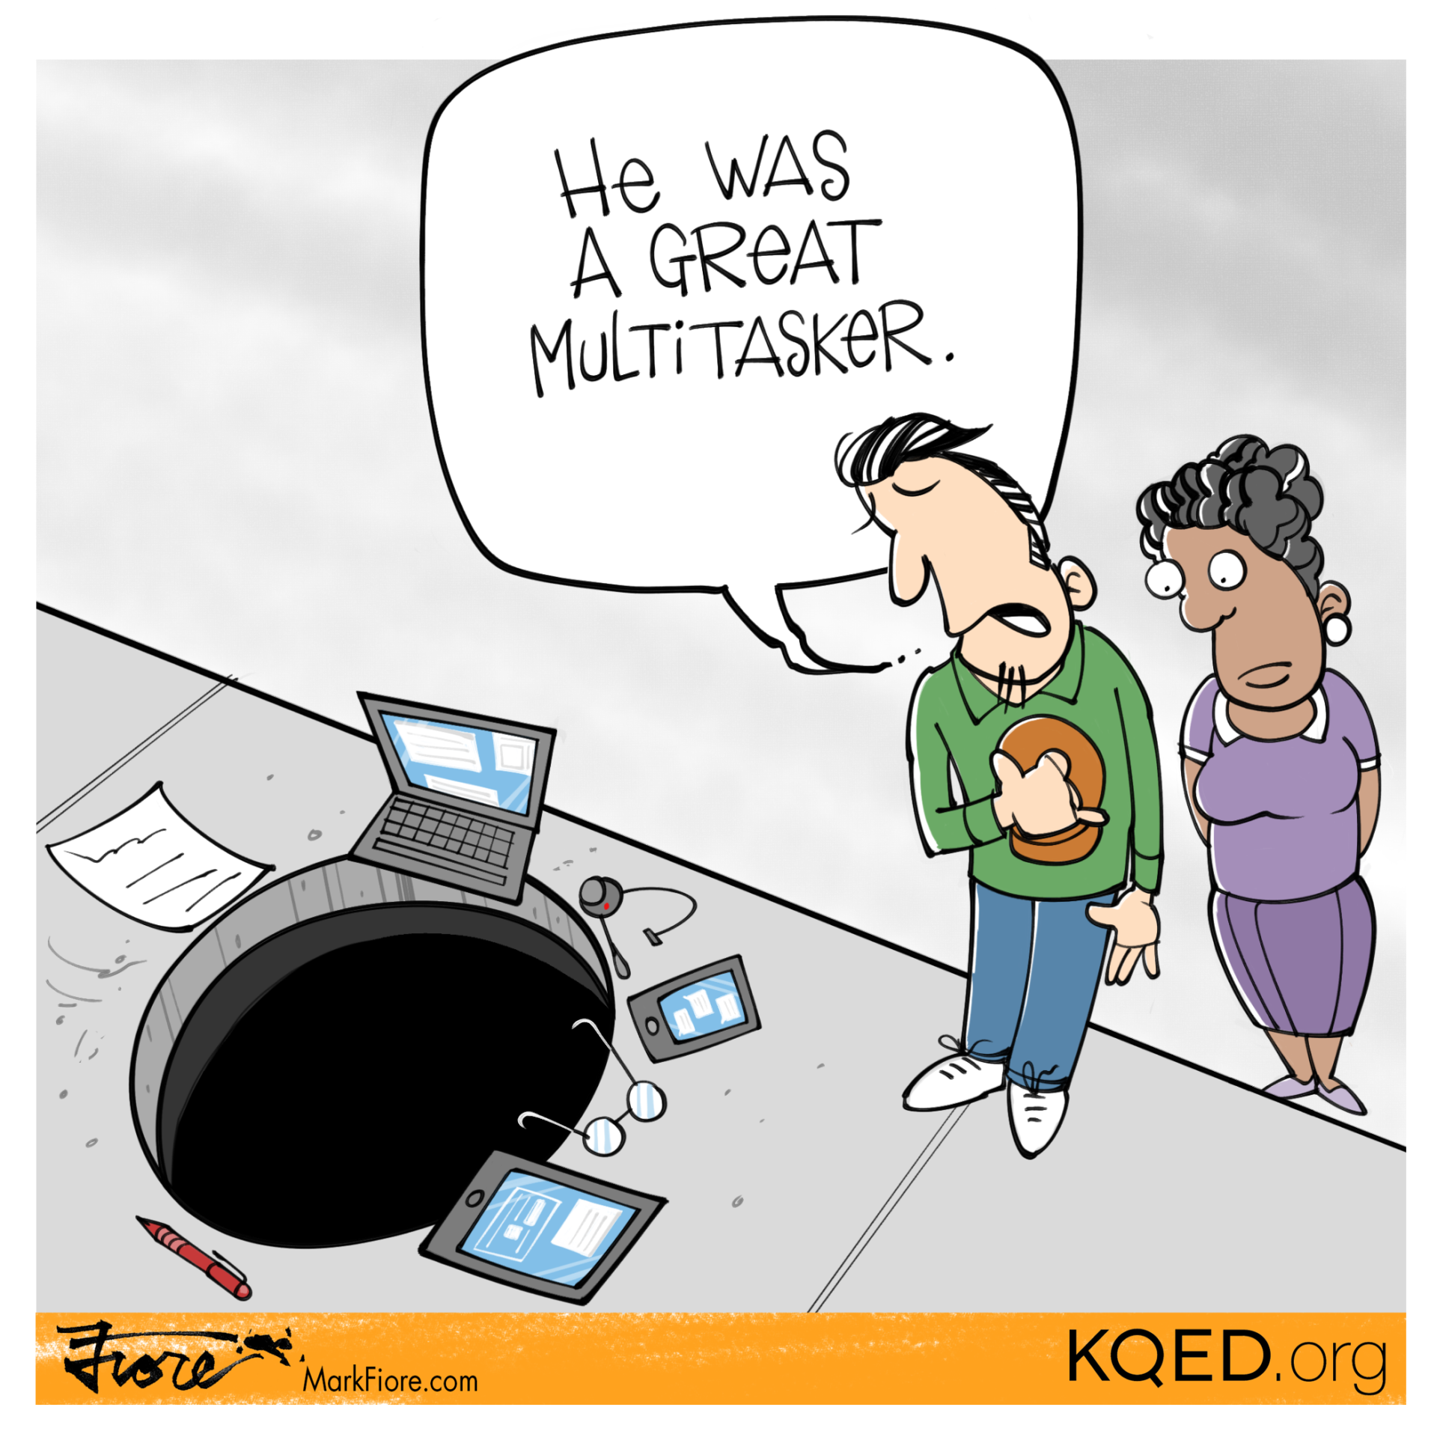
Paradox 2: Autonomy
+
Flexibility
-
Lower quality interactions
Higher quantity interactions
Role interference

Slide 11
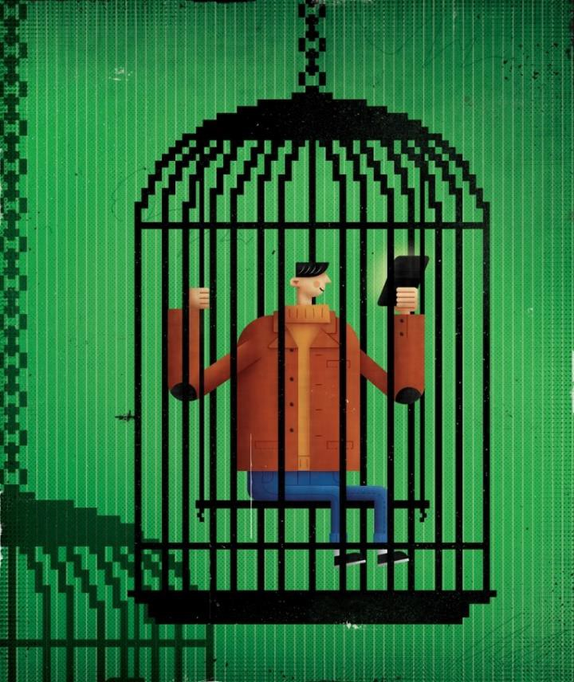
Autonomy
Digital surveillance
Ex. monitoring employee performance
Always on culture
Be available both during and outside work
Fueled by organizational norms, expectations, controlling leadership
Stress, tension
Lack of recovery (Barber & Santuzzi, 2015)
Blurring of boundaries :
work-life conflict (Boswell & Olson Buchanan, 2007)

Slide 12
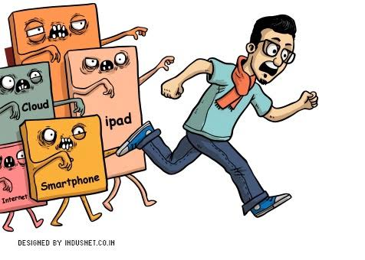
Paradox 3: Productivity
+
Efficiency
Flexibility
-
Overload
Lower quality interactions
Higher quantity interactions
Role interference

Slide 13
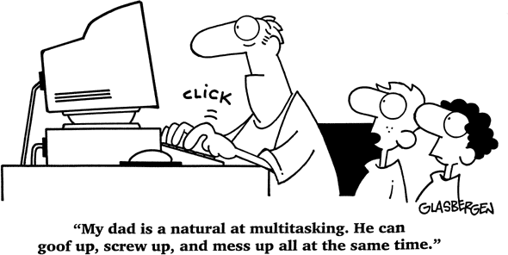
Did you know…?
Knowledge workers switch between tasks every 3 minutes (Gonzalez & Mark, 2004)
Employees check their email 36 times an hour (Czerwinski et al., 2004)
On average, employees spend 28% of their time on emails (McKinsey Global Institute, 2012)

Slide 14
Insert: technostress (Ragu-Nathan et al., 2008)
Being available anytime, anywhere: feeling obligated to stay connected all the time
Blurring of the boundaries between work and private life
invasion
overload
Forced to work more and faster, constant interruptions
complexity
Gaining new knowledge and skills to understand complex ICTs
uncertainty
Uncertainty about the operation of the technology, continuous adjustment
insecurity
Threat to job security (e.g. by colleagues who have better ICT skills)

Slide 15
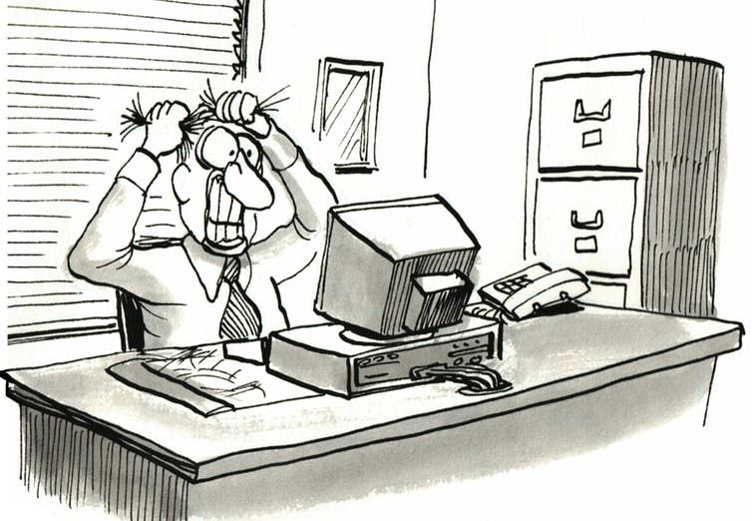
We need a balance between
“connection” en “disconnection” !

Slide 16
Digital disconnection: what and why?

Slide 17
Latest trends in popular streams

Slide 18
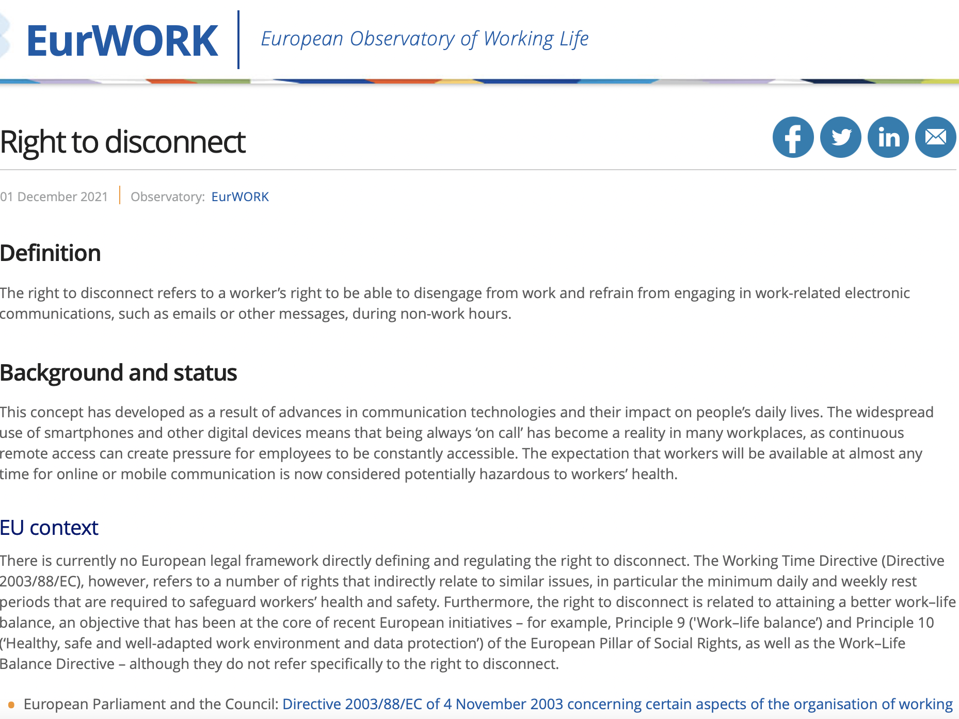
European Legislation
https://www.eurofound.europa.eu/observatories/eurwork/industrial-relations-dictionary/right-to-disconnect

Slide 19
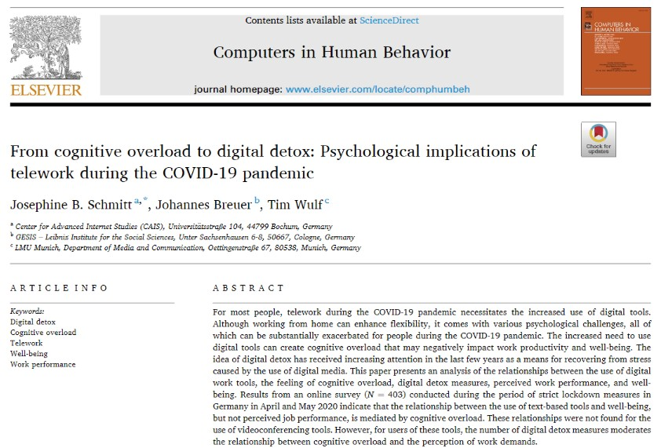
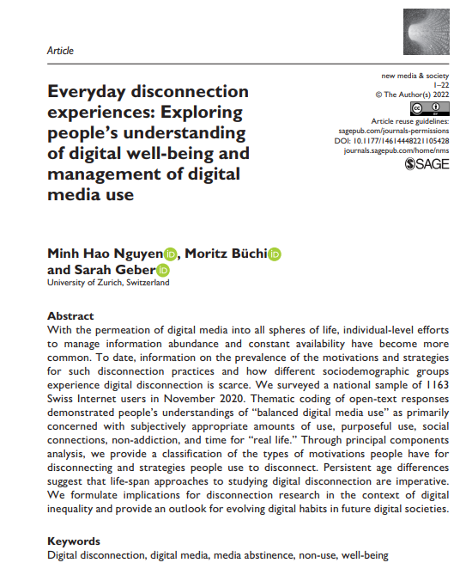
Research
35
Faculty of Economics and Business - Work & Organisation Studies

Slide 20
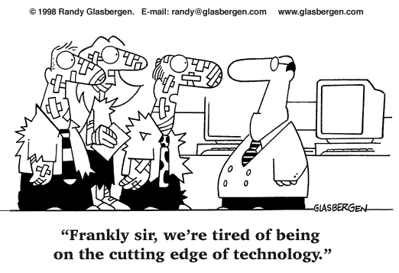
Digital disconnection: what?
Literature review and in-depth qualitative study with employees (N = 39)
“Voluntary, intentional actions taken by employees to limit the use of ICT”
Verlinden, Baillien, Geldof, & Verbruggen (in press). Finding balance in the digital age: on employees’ regulation of their connectivity to work-related ICTs.

Slide 21
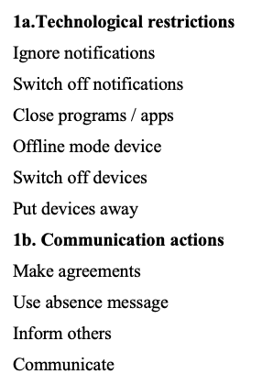
Multiple strategies and ”levels of intension”
Rarely completely disconnected; rather a combination of smaller actions
Context
When not at work (work)
Strategy
Focus on technology
Focus on communication
When at work (private… and work)
Focus on more general time management
Verlinden, Baillien, Notelaers, & Verbruggen (2nd review). Always on? Development and validation of the Employee Digital Disconnection Scale (EDDS). Work & Stress.

Slide 22
Digital disconnection: why?
Evolve towards ‘digital wellbeing’!
Subjective experience of balance in the use of ICTs
'Optimum' : minimal disadvantages (e.g. interruptions), maximum benefits (e.g. communication efficiency) in ICT use
Vanden Abeele, M. M. (2021). Digital wellbeing as a dynamic construct. Communication Theory, 31(4), 932-955.

Slide 23
Digital Wellbeing

Slide 24
What can the organisation do?

Slide 25
Digital wellbeing
KEY IS FIT!
Not: the more, the better
But: the more adjusted, the better
Individual differences
Digital (dis)connection
Contextual differences

Slide 26
Ingredients of a disconnection policy
Informed
Inter-connecting
Integrated
Survey: needs and preferences
Embedded in broader wellbeing policy
Connection opportunities Consider type of work
Involved
Input from employees Inform/inspire
Vranjes, I. & Van den Broeck, A.. (2022).

Slide 27
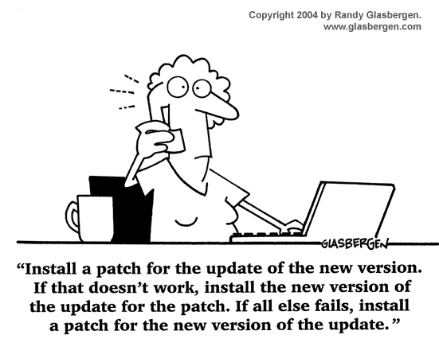
Time to disconnect!
Elfi.Baillien@kuleuven.be

