Slide 1
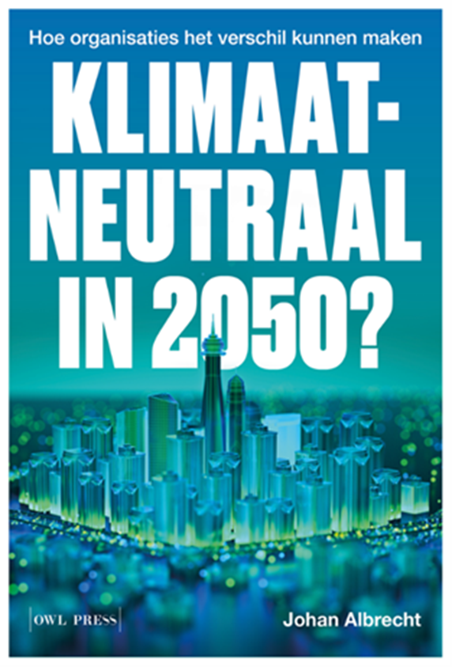
Radical innovation and energy system inertia; can the mission economy solve the climate puzzle?
Johan Albrecht
Universiteit Gent - Faculteit Economie & Bedrijfskunde
MERI/BELSPO, 25 04 2024

Slide 2
Fossil system resilience
Share fossil fuels (world);
86,6% in 1971 – 81% in 2000 - 80,9% in 2019 – 0% in 2050?
Share fossil fuels (Europe);
82% in 1990 – 78% in 2005 – 69% in 2021 – 0% in 2050?
BE (2022): 74%
(Europe; no expansion of energy systeem between 1990 and 2021)
Sources: IEA (2021). World Energy Balances: Overview (https://www.iea.org/data-and-statistics/charts/total-primary-energy-supply-by-fuel-1971-and-2019) & Eurostat, Energy Statistics, https://ec.europa.eu/eurostat/statistics-explained/index.php?title=Energy_statistics_-_an_overview

Slide 4
How to reshape the complete energy landscape?
No pause button for the fossil energy system; existing systems cannot be turned off because there is a high need for continuous service provision
We add new assets next to existing assets in the easy phase of the energy transition
“Correct the market forces and leave it to the market”: MFT (Market Failure Theory) or economic incentives + R&D support
“Mission economy” with a new and steering role for the state

Slide 5
Electricity in Europe: renewables do not (yet) push fossil-based generation capacity (MW) out of the market

Slide 7
Global climate change is a serious problem calling for immediate national action. Guided by sound economic principles, we are united in the following policy recommendations.
I. A carbon tax offers the most cost-effective lever to reduce carbon emissions at the scale and speed that is necessary. By correcting a well-known market failure, a carbon tax will send a powerful price signal that harnesses the invisible hand of the marketplace to steer economic actors towards a low-carbon future.
II. A carbon tax should increase every year until emissions reductions goals are met and be revenue neutral to avoid debates over the size of government. A consistently rising carbon price will encourage technological innovation and large-scale infrastructure development. It will also accelerate the diffusion of carbon-efficient goods and services.
III. A sufficiently robust and gradually rising carbon tax will replace the need for various carbon regulations that are less efficient. Substituting a price signal for cumbersome regulations will promote economic growth and provide the regulatory certainty companies need for long- term investment in clean-energy alternatives.

Slide 8
A European Green Deal (2019) Striving to be the first climate-neutral continent

Slide 9
δ market price ≠ CO₂-price

Slide 10
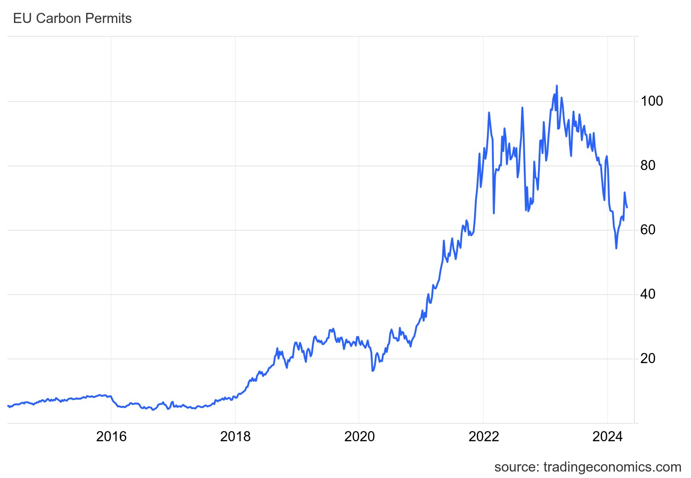
EU ETS price (€/tCO₂) and the price of your cornflakes?

Slide 11
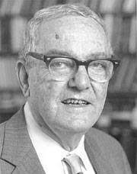
‘We do not live in a market economy, but in an organization economy, or at most in an organization/market economy with a predominance of organizational over market activity.’ (Herbert Simon, Nobel Prize Economics 1978)

Slide 12
IEA (2023). CO₂ Emissions in 2022 https://iea.blob.core.windows.net/assets/3c8fa115-35c4-4474-b237-1b00424c8844/CO2Emissionsin2022.pdf
“… the European Union reduced its emissions by 2.5% (or 70 Mt), thanks to a mild winter, effective energy conservation measures, fuel switching, behavioural changes, and industrial production curtailments. Reduced natural gas emissions more than offset increases in emissions from coal and oil. Buildings sector emissions declined the most, by 60 Mt, enabled by exceptionally mild weather from October to December 2022 – the second warmest start to winter in the last 30 years – and collective energy conservation measures. Meanwhile industry sector CO₂ emissions declined by 42 Mt…”

Slide 13
‘Mainstream economic perspectives of simply solving climate change with a carbon tax and some R&D subsidies (to let markets find the optimal pathway), combined with political economic impediments to carbon taxes, have left us with negligent carbon tax systems and a worryingly slow green transition … Economists have failed to realize and set out the reasoning for transformative public investment and regulation that accomplish what CO₂ tax cannot on its own (Mazzucato, Mission Economy, p.142).
Our lethargic transition pace, globally, is a lesson in what can happen if government leaves the market to sort out problems and abstains from assuming its entrepreneurial role in society (p.143)’

Slide 14
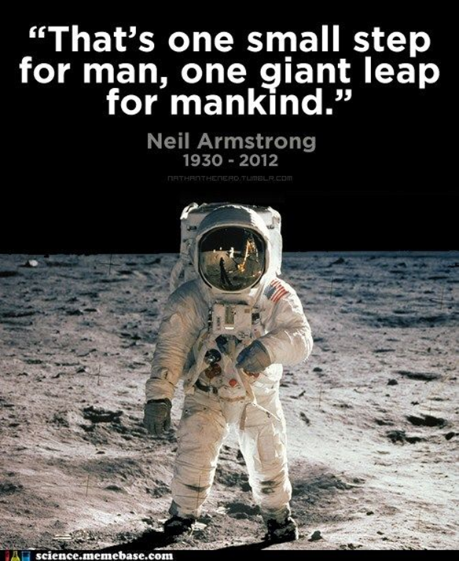
John F. Kennedy, 1962
“We choose to go to the moon. We choose to go to the moon in this decade and do the other things, not because they are easy, but because they are hard, because that goal will serve to organize and measure the best of our energies and skills, because that challenge is one that we are willing to accept, one we are unwilling to postpone, and one which we intend to win, and the others, too.”
“To be sure, all of this costs us all a good deal of money. … even though I realize that this is in some measure an act of faith and vision, for we do not now know what benefits await us
(https://www.rice.edu/jfk-speech).”

Slide 15
Apollo programme (1960-1973)
Commercial innovations from Apollo; software, software engineering, integrated circuits, miniaturization of computers (first portable computer), communication & navigation technologies, LED, photovoltaics, water purification, medical technologies, insulation materials, smoke detector, …
Integrated circuits became the basis for the entire US computer industry
Apollo reshaped modern society in four decades
Management methods with the public sector in the driving seat, outcome-based policymaking; 300 000 to 400 000 people were involved, drawn from 20,000 contractors and 200 universities in eight countries as well as from NASA itself – ‘systems management’, ‘matrix management’
1960-1973 (2020$): $ 257 - $ 283 bill (or 19,7 - $ 21,7 bill per year)

Slide 16
Research in the 1960s & 1970s…
A necessity, not just a job (~mRNA vaccines in 2021)
‘Pay for performance’ (and not for labour effort) & cost-plus contracts (in a very narrow time frame)
‘Pure’ researchers instead of bureaucrats
No CBA, focus on outcomes!
In a risk-loving climate that favours radical innovation (research calls nowadays stiffle radical innovation)

Slide 17
Apollo programme?
Apollo created and shaped a unique collective and competitive research market, based on public-private collaboration
Societal impact of Apollo innovations in the 1970s, 1980s, 1990s and beyond is a success story of free markets
Imagine the Soviet Union owned all the ‘Apollo innovations’ in 1973
Markets cannot create the initial radical innovations but triggered incremental innovation and enabled the scaling-up of new technologies
Apollo; rather solid application of MFT because free market could not bring people to the moon

Slide 18
A ‘low-carbon’ or ‘net-zero’ Apollo program to save the climate?
Yes, but such a public programme requires unique expertise to manage performance-based research contracts with the private sector
NASA was a public R&D front-runner with exceptional scientists and engineers before the launch of Apollo. It still is?
Does Europe have public R&D front-runners to manage a comprehensive ‘low-carbon’ or ‘net-zero’ programme? Output of European R&D programmes?
Mazzucato; ‘in many areas public institutions have lost the confidence to act, as well as the capability to act’ (~ outsourcing of essential expertise and knowledge to consultancy firms)
First priority is in-house development of capabilities in public (research) institutions, but this can take decades

Slide 19
Reinventing government?
EU Green Deal (2019) -> mission is already known and science-based
Challenge 1: European technocrats are not elected but can impose very radical and risky transformations on the member states
Challenge 2: the trajectories towards the Green Deal goals remain opaque
Challenge 3: the complexity of the mission is already narrowed to electrify everything and invest in renewable generation capacity; ‘build wind turbines, buy a Tesla, buy a heat pump,…’ : governments already shaped and subsidized oligopolistic markets
Did government ‘pick winners’ or did ‘loosers pick government’?

Slide 20
Some conclusions
The pace of the energy transition is lethargic but Apollo is a solid application of dynamic efficiency of free markets
Apollo: unique and radical R&D market + 4 decades to transform society (unintentionally, without regulation)
2019 Green Deal; Europe is already a ‘mission economy’ (on paper) but governments lack capacity to manage transition trajectories
Europe so far mainly shapes and subsidizes oligopolistic markets (‘electrify everything’), an invitation for static and dynamic inefficiency
For a radical transformation, we have to organize radical research markets. Is there a radical and outcome-based innovation proposition in the Green Deal?

Slide 21
Thank you for your attention!
johan.albrecht@ugent.be
https://www.itinerainstitute.org/
https://www.itinera.team/nl/experten/johan-albrecht

