Slide 1
Technologies for circularity -- Challenges in mapping and monitoring
Julie Callaert (KU Leuven)
25/04/2024
BELSPO-MERI Conference

Slide 2
Monitoring circularity: policy importance
Achieving environmental sustainability goals (including pollution prevention, waste management, promoting sustainable production and consumption)
Sustaining economic growth
Facilitating knowledge sharing through international collaboration
Securing resources and creating / maintaining resilience
Ensuring social equity and inclusion (?)

Slide 3
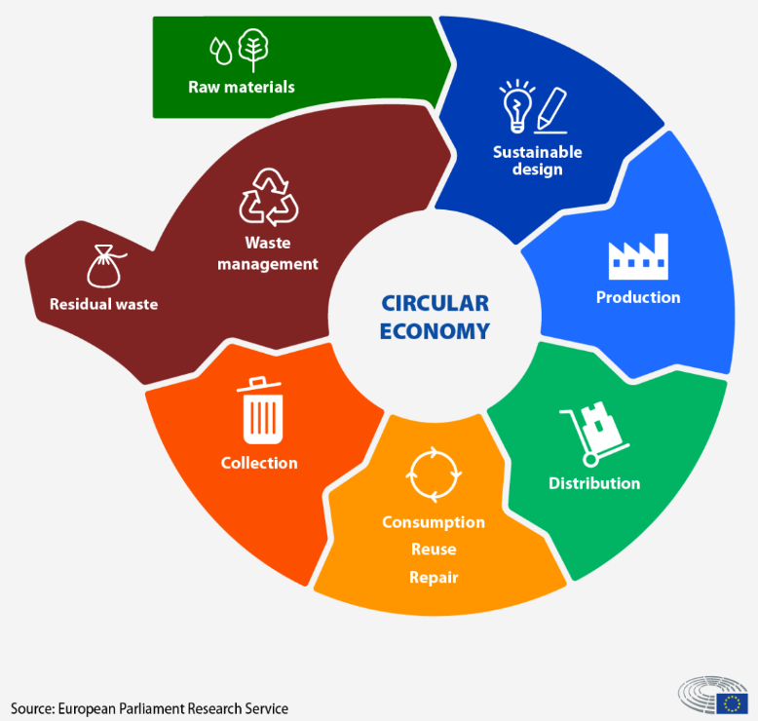
Establishing the concepts
CIRCULAR ECONOMY
A system which maintains the value of products, materials and resources in the economy for as long as possible, and which minimizes the generation of waste. This means a system where products are reused, repaired, remanufactured or recycled. (EU definition - 2021)
An economy that focuses on reducing the lifecycle impacts of materials. Based on a systems-focused approach, it involves industrial processes and economic activities that are restorative or regenerative by design, enabling resources used in such processes and activities to maintain their highest value for as long as possible, and aiming for the elimination of waste. (paraphrased from the US 2020 Save Our Seas Act)
As such: circularity goes beyond recycling. Recycling is “end-of-pipe”, while a circular economy goes upstream to avoid and address potential problems at earlier stages (products design stage). Preventing waste, to try and avoid the need to recycle (reuse, repair and remanufacture instead).

Slide 4
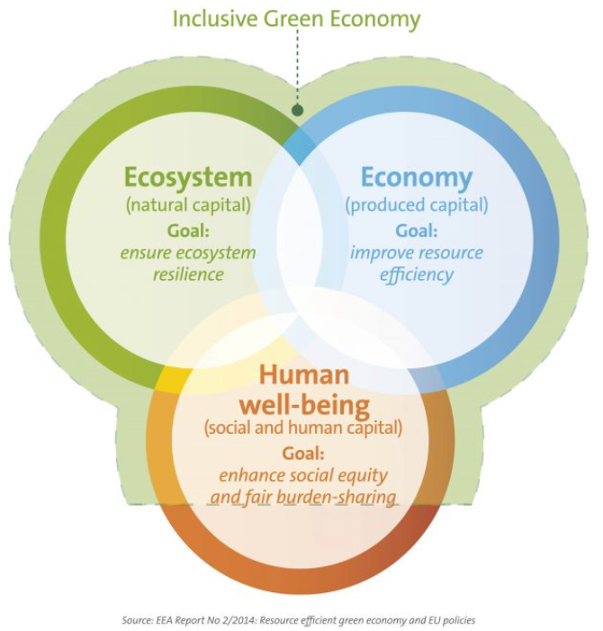
Establishing the concepts
GREEN ECONOMY
An economy in which environmental, economic and social policies and innovations enable society to use resources efficiently, enhancing human well-being in an inclusive manner, while maintaining the natural systems that sustain us (EEA definition – 2014)
An economy that results in increasing well-being and social equality, while significantly reducing environmental risks and ecological scarcity. In its simplest expression, a Green Economy can be thought of as one which is low carbon, resource efficient and socially inclusive (UNEP definition, 2011)
Green technology: The development and application of innovations that reduce or undo the environmental damage caused by human activity, that repair existing damage and that promote regeneration.

Slide 5
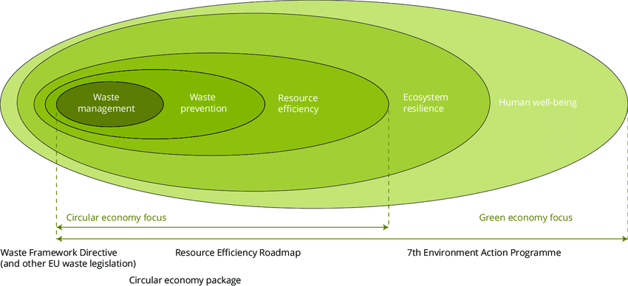
Establishing the concepts
Sustainability as umbrella concept
Circular economy focuses on resource cycles and supply/value chains, whereas Green economy relates more to people and economy
A circular economy can fit into a green one, but not the other way around
(Source: EEA Report No 2/2016)

Slide 6
Technologies for circularity
Circularity: broad and multi-faceted concept, with many intricate mutual connections between elements
Poses considerable challenges for monitoring and mapping
One entry point: evaluating separate components of the concept
Technology as an essential component / enabler

Slide 7
Technologies for circularity
The challenge of delineation
“Core” / Direct: Waste management technologies; Technologies for resource collection, purification, storage and conservation; Pollution abatement technologies; Renewable energy technologies (for use in construction, transportation, manufacturing,..)
“Enabling” / Indirect: Technologies designed for other purposes, but potentially and indirectly contributing to materials, processes and machinery that enable circularity

Slide 8
Technologies for circularity
Existing delineations
EPO: Y02 tagging scheme
WIPO: IPC Green inventory
OECD: ENV-TECH scheme

Slide 9
Technologies for circularity
Consider how these delineations are positioned / presented:
OECD: selected environment-related technologies → to measure environmental innovation based on patent data
WIPO: IPC Green inventory → facilitates searches for patent information relating to Environmentally Sound Technologies (ESTs, cf. UN Framework Convention on Climate Change)
EPO: Y02 tag relating to Climate Change Mitigation Technologies (inventories of the Y tags are developed and updated by running search algorithms designed by expert examiners and relying on CPC symbols, IPC symbols and keywords) → to ease access to patent documentation in sustainable technologies
Not aimed as such at capturing ‘circularity’; but widely used as a measurement base for capturing the technological aspect of circularity.

Slide 10
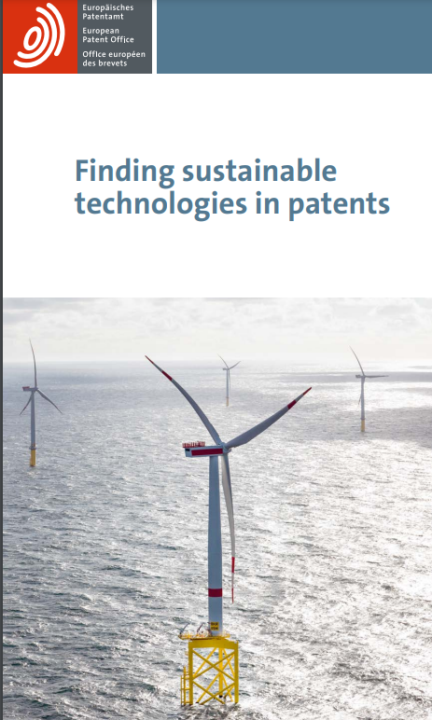
Technologies for circularity
DELINEATION | CLASSIFICATION | MAIN CLASSES
WIPO (IPC Green inventory) | +/- 5.000 IPC codes | Alternative Energy Production Transportation Energy Conservation Waste Management Agriculture; Forestry Administrative, regulatory or design aspects Nuclear power generation
OECD (ENV/TECH) | +/- 1.000 IPC codes +/- 250 out of 300 Y02 tags (CPC codes) | Environmental Management Water-related adaptation technologies Biodiversity protection and ecosystems health CCMT related to energy generation, transmission or distribution Capture, storage, sequestration or disposal of greenhouse gases CCMT related to transportation CCMT related to buildings
EPO (Y02 tagging scheme) | +/- 300 Y02 tags (CPC codes) | Technologies for adaptation to climate change CCMT in ICT, i.e. ICT aiming at the reduction of their own energy use Reduction of greenhouse gas emissions, related to energy generation, transmission or distribution Capture, storage, sequestration or disposal of greenhouse gases CCMT in the production or processing of goods CCMT related to transportation CCMT related to buildings

Slide 11
Technologies for circularity
Which one(s) to select? And does it even matter?
Comparison:
For each of the 3 delineations:
Extraction of EPO patents
By EU-27 country (period 2012-2022)

Slide 12
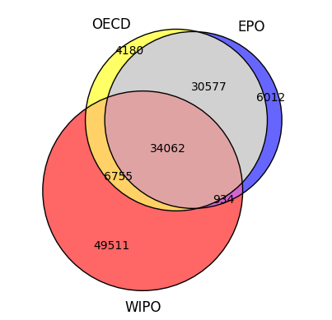
Comparing delineations: overlap
Overlap in patent volumes (EPO applications, EU-27, 2012 – 2022)
WIPO <> OECD & EPO
OECD & EPO: predominantly driven by CPC coding scheme
WIPO goes broader in several domains, especially:
Data processing systems
Measurement systems
Genetic engineering
Biocides, (plant) tissue culture, horticulture
Chemistry: organic compounds (carboxylic acids and esters)
Nuclear physics and nuclear engineering

Slide 13
Comparing delineations: trends

Slide 14
Comparing delineations: top players (BE)
OECD |  | EPO |  | WIPO
1. SOLVAY | 181 | 1. SOLVAY | 156 | 1. IMEC (INTERUNIVERSITY MICROELECTRONICS CENTRE) | 110
2. UMICORE & COMPANY | 128 | 2. UMICORE & COMPANY | 126 | 2. SOLVAY | 109
3. SAFRAN AERO BOOSTERS | 97 | 3. KATHOLIEKE UNIVERSITEIT LEUVEN | 119 | 3. KATHOLIEKE UNIVERSITEIT LEUVEN | 92
4. PLASTIC OMNIUM ADVANCED INNOVATION & RESEARCH | 93 | 4. GLAXOSMITHKLINE BIOLOGICALS | 108 | 4. VITO (VLAAMSE INSTELLING VOOR TECHNOLOGISCH ONDERZOEK) | 88
5. VITO (VLAAMSE INSTELLING VOOR TECHNOLOGISCH ONDERZOEK) | 88 | 5. SAFRAN AERO BOOSTERS | 83 | 5. GHENT UNIVERSITY | 83
6. IMEC (INTERUNIVERSITY MICROELECTRONICS CENTRE) | 76 | 6. IMEC (INTERUNIVERSITY MICROELECTRONICS CENTRE) | 82 | 6. VIB (VLAAMS INTERUNIVERSITAIR INSTITUUT VOOR BIOTECHNOLOGIE) | 65
7. KATHOLIEKE UNIVERSITEIT LEUVEN | 68 | 7. PLASTIC OMNIUM ADVANCED INNOVATION & RESEARCH | 78 | 7. ATLAS COPCO AIRPOWER | 63
8. AGC GLASS EUROPE | 56 | 8. VITO (VLAAMSE INSTELLING VOOR TECHNOLOGISCH ONDERZOEK) | 72 | 8. PLASTIC OMNIUM ADVANCED INNOVATION & RESEARCH | 58
9. LHOIST RECHERCHE & DEVELOPPEMENT | 42 | 9. AGC GLASS EUROPE | 57 | 9. GLAXOSMITHKLINE BIOLOGICALS | 56
10. INERGY AUTOMOTIVE SYS RESEARCH | 41 | 10. GHENT UNIVERSITY | 51 | 10. DAIKIN EUROPE | 49
11. DAIKIN EUROPE | 37 | 11. VIB (VLAAMS INTERUNIVERSITAIR INSTITUUT VOOR BIOTECHNOLOGIE) | 36 | 11. MELEXIS TECH | 33
12. GHENT UNIVERSITY | 36 | 12. INERGY AUTOMOTIVE SYS RESEARCH | 34 | 12. BAYER CROPSCIENCE | 31
13. TOTAL RESEARCH & TECH FELUY | 32 | 13. TOTAL RESEARCH & TECH FELUY | 32 | 13. INERGY AUTOMOTIVE SYS RESEARCH | 30
14. ELECTROLUX HOME PRODUCTS CORPORATION | 31 | 14. DAIKIN EUROPE | 32 | 14. AGC GLASS EUROPE | 26
15. TOYOTA MOTOR EUROPE | 30 | 15. ELECTROLUX HOME PRODUCTS CORPORATION | 31 | 15. COCKERILL MAINTENANCE & INGENIERIE | 24
16. ZF WIND POWER ANTWERPEN | 30 | 16. ZF WIND POWER ANTWERPEN | 30 | 16. VRIJE UNIVERSITEIT BRUSSEL | 24
17. ATLAS COPCO AIRPOWER | 29 | 17. SCHREDER | 28 | 17. ZF WIND POWER ANTWERPEN | 23
18. SCHREDER | 28 | 18. TOYOTA MOTOR EUROPE | 25 | 18. UMICORE & COMPANY | 22
19. LAYERWISE | 22 | 19. LHOIST RECHERCHE & DEVELOPPEMENT | 23 | 19. LHOIST RECHERCHE & DEVELOPPEMENT | 22
20. COCKERILL MAINTENANCE & INGENIERIE | 22 | 20. LAYERWISE | 22 | 20. SCHREDER | 20
21. BOSAL EMISSION CONTROL SYS | 21 | 21. COCKERILL MAINTENANCE & INGENIERIE | 22 | 21. UNIVERSITE DE LIEGE | 20
22. MATERIALISE | 21 | 22. MATERIALISE | 21 | 22. TOTAL RESEARCH & TECH FELUY | 19
23. DEME OFFSHORE BE | 20 | 23. JANSSEN PHARMACEUTICA | 21 | 23. TOYOTA MOTOR EUROPE | 19
24. AGFA-GEVAERT | 19 | 24. UNIVERSITE DE LIEGE | 20 | 24. AGFA-GEVAERT | 19
25. KNAUF INSULATION | 18 | 25. DEME OFFSHORE BE | 20 | 25. CNH (CASE NEW HOLLAND) BELGIUM | 19

Slide 15
Comparing delineations: country rankings

Slide 16
Comparing delineations: country rankings
Country | rank WIPO | rank OECD | WIPO benefit?
Denmark | 1 | 1 | 0
Estonia | 2 | 8 | 6
Lithuania | 3 | 18 | 15
Bulgaria | 4 | 3 | -1
Latvia | 5 | 2 | -3
Spain | 6 | 5 | -1
Netherlands | 7 | 20 | 13
Cyprus | 8 | 26 | 18
Slovakia | 9 | 11 | 2
Austria | 10 | 7 | -3
Portugal | 11 | 17 | 6
Poland | 12 | 12 | 0
France | 13 | 9 | -4
Germany | 14 | 6 | -8
Ireland | 15 | 27 | 12
Romania | 16 | 22 | 6
Belgium | 17 | 13 | -4
Slovenia | 18 | 19 | 1
Czech Republic | 19 | 14 | -5
Finland | 20 | 15 | -5
Hungary | 21 | 23 | 2
Croatia | 22 | 10 | -12
Italy | 23 | 16 | -7
Sweden | 24 | 21 | -3
Greece | 25 | 24 | -1
Malta | 26 | 25 | -1
Luxembourg | 27 | 4 | -23
Rank order correlations (Spearman’s rho)
 |  | OECD delineation | EPO delineation
EPO delineation | Corr. Coëff. | ,818**
 | (Sign. Level) | (<,001)
WIPO delineation | Corr. Coëff. | ,427* | ,393*
 | (Sign. Level) | (-0,026) | (-0,042)

Slide 17
Comparing delineations
Although there is considerable overlap in the existing delineations,
Switching between them implies non-trivial shifts in indicators on a micro- and a macro level.
This has been illustrated when comparing delineations of the ‘core’ technologies for circularity.
Additional consideration: to what extent do we actually capture ‘circular’ technologies with these existing delineations?

Slide 18
Capturing circularity?
Case illustration:
3 companies specialized in developing machines and procedures for sorting materials.
→ Directly contributing to circular economy
Solutions that enable the circular economy with advanced collection and sorting systems
NIR spectroscopy solutions to enable proper sorting of material, improving recyclability
and recycling streams
Sorting and baling systems for the textile and recycling industries, with (a.o.) AI-based models to identify and separate textiles based on fiber composition and color properties

Slide 19
Capturing circularity?
Expectation: their patent portfolios would be identified as belonging to ‘circular’ technologies
Reality: less than 20% of their patents are captured by the delineations
 | Total # patents | % in WIPO | % in EPO | % in OECD
TOMRA SORTING | 10 | 0% | 20% | 20%
TOMRA SYS | 20 | 20% | 5% | 20%
TRINAMIX | 74 | 19% | 15% | 15%
VALVAN | 6 | 0% | 0% | 0%

Slide 20
Capturing circularity?
A closer look at patent level:
Patent_number | Application year | Title | Captured?
458401120 | 2016 | NOZZLE DEVICE AND SYSTEM FOR SORTING OBJECTS
483282037 | 2017 | CLASSIFICATION METHOD AND APPARATUS
486129855 | 2017 | A METHOD AND SYSTEM FOR DETECTING A DIAMOND SIGNATURE
499402536 | 2018 | CLASSIFICATION METHOD AND APPARATUS
521478234 | 2019 | NEURAL NETWORK FOR BULK SORTING
532224141 | 2020 | METHOD AND SYSTEM FOR TRAINING A NEURAL NETWORK-IMPLEMENTED SENSOR SYSTEM TO CLASSIFY OBJECTS IN A BULK FLOW
540397394 | 2020 | NEURAL NETWORK FOR BULK SORTING
547370058 | 2021 | ROBOTIC SYSTEM AND METHOD FOR SORTING WASTE WITH SUCTION GRIPPER
550421430 | 2021 | APPARATUS FOR DETECTING MATTER
558897780 | 2021 | COOLING DEVICE FOR OPTICAL AND/OR ELECTRONIC ELEMENTS

Slide 21
Capturing circularity?
Title | Diagnosis
NOZZLE DEVICE AND SYSTEM FOR SORTING OBJECTS | B05B (SPRAYING APPARATUS; ATOMISING APPARATUS; NOZZLES)
CLASSIFICATION METHOD AND APPARATUS | B07C (POSTAL SORTING; SORTING INDIVIDUAL ARTICLES, OR BULK MATERIAL FIT TO BE SORTED PIECE-MEAL, e.g. BY PICKING)
A METHOD AND SYSTEM FOR DETECTING A DIAMOND SIGNATURE | G01N (INVESTIGATING OR ANALYSING MATERIALS BY DETERMINING THEIR CHEMICAL OR PHYSICAL PROPERTIES)
NEURAL NETWORK FOR BULK SORTING | G06K 9 --- G06V 10
METHOD AND SYSTEM FOR TRAINING A NEURAL NETWORK-IMPLEMENTED SENSOR SYSTEM TO CLASSIFY OBJECTS IN A BULK FLOW | G06K 9 (Methods or arrangements for reading or recognising printed or written characters or for recognising patterns, e.g. fingerprints)
NEURAL NETWORK FOR BULK SORTING | G06V 10 (Arrangements for image or video recognition or understanding)
ROBOTIC SYSTEM AND METHOD FOR SORTING WASTE WITH SUCTION GRIPPER | B25 (HAND TOOLS; PORTABLE POWER-DRIVEN TOOLS; HANDLES FOR HAND IMPLEMENTS; WORKSHOP EQUIPMENT; MANIPULATORS)
APPARATUS FOR DETECTING MATTER | B07C --- G01N
COOLING DEVICE FOR OPTICAL AND/OR ELECTRONIC ELEMENTS | H05K (PRINTED CIRCUITS; CASINGS OR CONSTRUCTIONAL DETAILS OF ELECTRIC APPARATUS; MANUFACTURE OF ASSEMBLAGES OF ELECTRICAL COMPONENTS)

Slide 22
Concluding reflections
Existing delineations are overlapping but not similar → shifting stats and figures
Give thorough consideration to which one to choose (no one-size-fits-all, depending on the objective of the mapping / monitoring)
Existing delineations are useful building blocks, but do not provide the full picture
Room for refinement (e.g. complementing domain searches with keyterm searches / text mining): towards a modular (and transparent) classification scheme?

Slide 23
Concluding reflections
And even then:
It seems more appropriate to speak about ‘technologies ENABLING circularity’, rather than about ‘circular technologies’
Patents: can capture such enabling technologies (in different degrees of width → modular approach); and can as such be part of a circularity index
At the same time: these technologies can serve circular purposes as well as non-circular (or even counter-circular) purposes
Crucial point: the extent to which users of those technologies translate them into applications that effectuate circularity (applicability → enforceability?)
Circularity: encompassing concept, beyond technicality of processes → revolves around the value chain and architectural innovation
As such: the development of circularity-enabling technologies is a necessary but not a sufficient condition for achieving a circular economy

Slide 24
Contact: julie.callaert@kuleuven.be

