Slide 1
Technologies for a sustainable future
The successive industrial revolutions led to an increase in environmental pollution, deteriorating ecosystems, biodiversity loss, and climate change.
But at the same time, we depend on the development of new technologies and innovations to mitigate and reduce the effects that were created by their predecessors.
Notes:
Dependence on fossil fuels: high-energy density
Diversification of dependence on energy sources, rationalization and improving energy efficiency

Slide 2
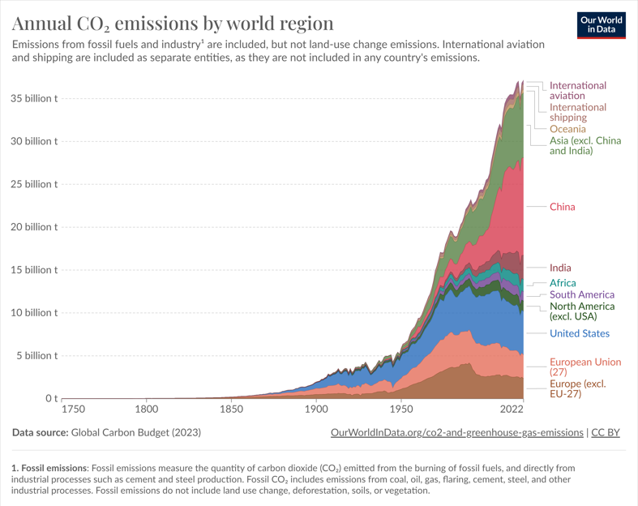
Timeline CO₂ emissions by world region

Slide 3
Technologies for an affluent society for everyone
Technological progress can have positive and negative effects on the labor market.
Distinction between the short and long run
During the early phases of the first industrial revolution -> working conditions and wages for factory workers declined. It was only in the long run (especially during the second industrial revolution) that middle-class societies became the norm in the Western world

Slide 4
Relation to productivity
New technologies and innovations -> no immediate effect: it may take several decades to materialize. Productivity gains become apparent when organizational adjustments are made.
Relation between productivity and real wages
Labor-replacing and labor-enabling technologies
Growing concern over the impact of AI

Slide 5
The context is essential
Acceptance or resistance to new technologies is always related to the social context
- industrial workers in the middle of the 19th century had a pessimistic view on technologies
- the 50’s and 60’s, Solow growth model, society was reaping the benefits of new innovations. People were optimistic about the impact of technology on their lives.

Slide 6
New approaches
Taxation of robots, investment in retraining, promotion of STEM education, wage insurance, …
Development of new norms to measure the performance of businesses (ESGs to evaluate credit worthiness), extend guarantees to fight programmed obsolescence, circular economy, …
New modes of funding (focus on SDGs)
Alternative economic models: degrowth models

Slide 7
Future critical questions
Is there too much techno-optimism? -> who/what determines the narrative behind it.
Do we need to place technology more under democratic control?
Should technological progress be directed toward more human-enhancing productivity growth (more worker-machine complementarity)?

