Slide 1


Attention to SDGs in EU funded research
Monitoring and Evaluation of Research and Innovation (MERI)
April 25, 2024
Kris Boudt, Yanick Inghels, André Spithoven
https://sdgdashboard.streamlit.app

Slide 2

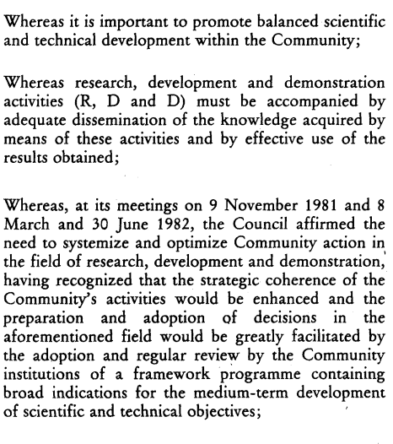
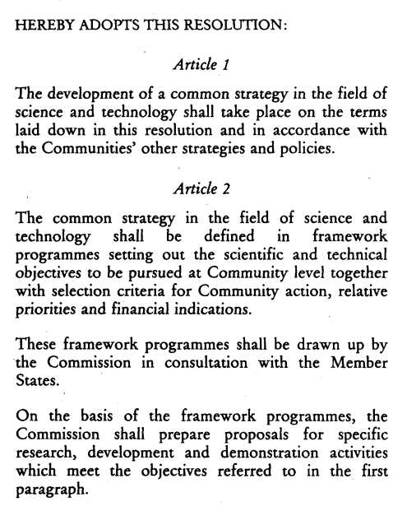
Source: https://eur-lex.europa.eu/legal-content/EN/TXT/PDF/?uri=CELEX:31983Y0804(01)
Notes:
Positive externalities that R&I has,

Slide 3
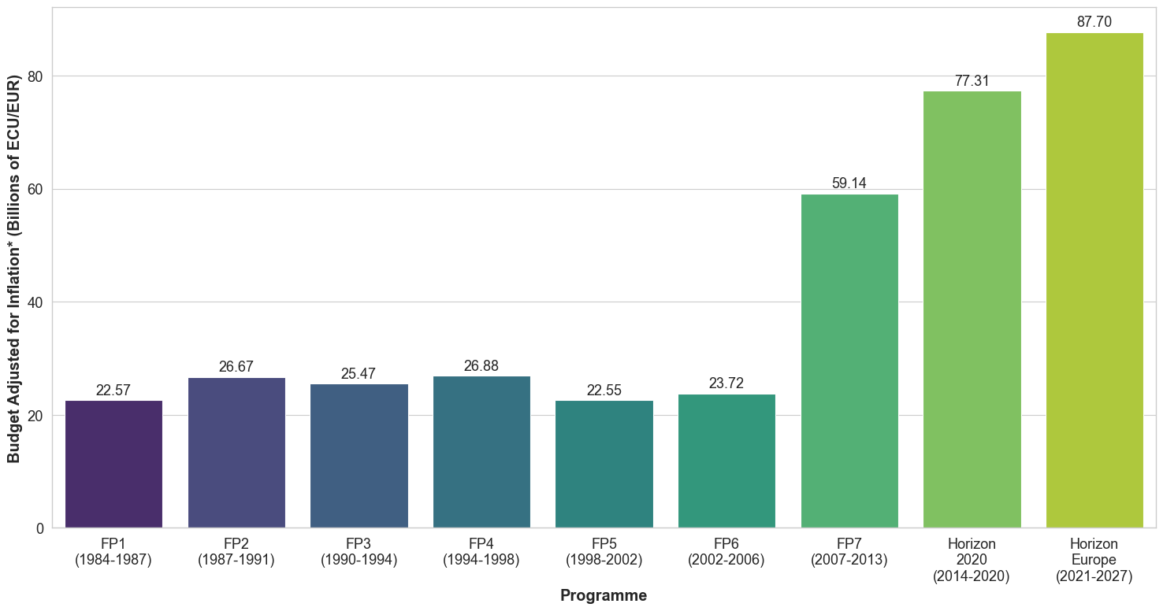
A multi-billion budget that more than doubled in 2007
‘Given the widely supported enlarged scope […] the need to enable the Community to meet new science and technology challenges […] to the effort of finding solutions to climate change and sustainability, […] as well as reinvigoration of the Lisbon strategy, there is a pressing need to progressively increase double the EU research budget’ (EC, 2006)
* Budgets are deflated using the IMF CPI at the Programmes starting years (2015=100)

Slide 4
  100,000+ grants funded
  How to summarize them using 17 meaningful dimensions?

Slide 5

Adoption by the UN of the SDGs on Jan 1 2016
The SDGs (building on the success of the Millennium Development Goals) aim to promote prosperity while protecting the planet.
Thematic approach: There are 17 SDGs
Common visualizations (SDG wheel, SDG cubes) seem to suggest that all SDGs are equally important

Slide 6
Not all SDGs should be funded equally
Are all SDGs equal in term of research budget allocation?
  Of course not!
  Efficient research financing should overweight the SDGs for which R&I has the potential to contribute most in progress
  That potential should be time-varying:
    Ever evolving research frontier
    Changing policy preferences
    Examples:
      Research on wind as a source of clean and affordable energy (SDG 7)
      Research on climate change (SDG 13)

Slide 7
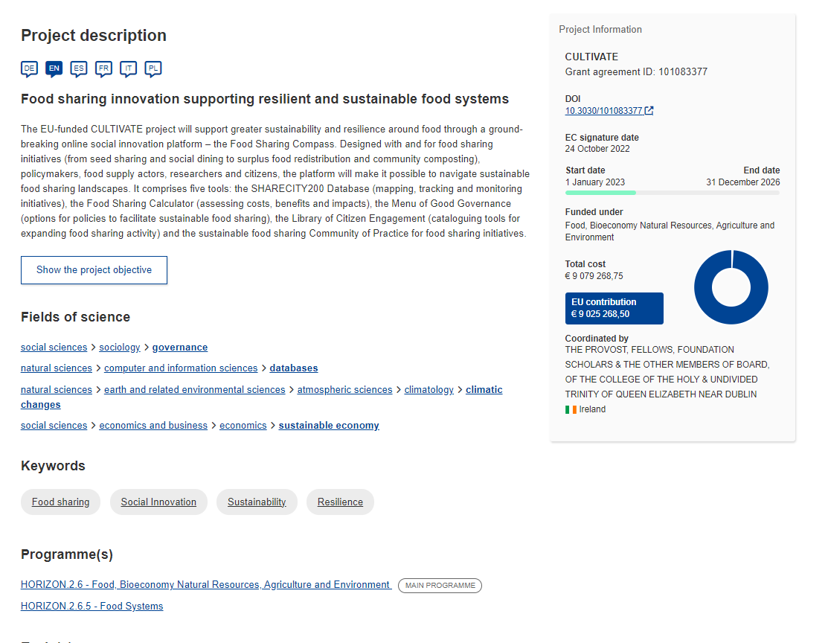
Data about funded research (CORDIS)
Cordis is waow!
100,000+ grants
Title, project description, FoS, keywords, budget, … are available
One information is missing: SDG
  SDG is not self-reported, would also not be possible pre-2016
  also no automated SDG labelling
  Except for…

Slide 8
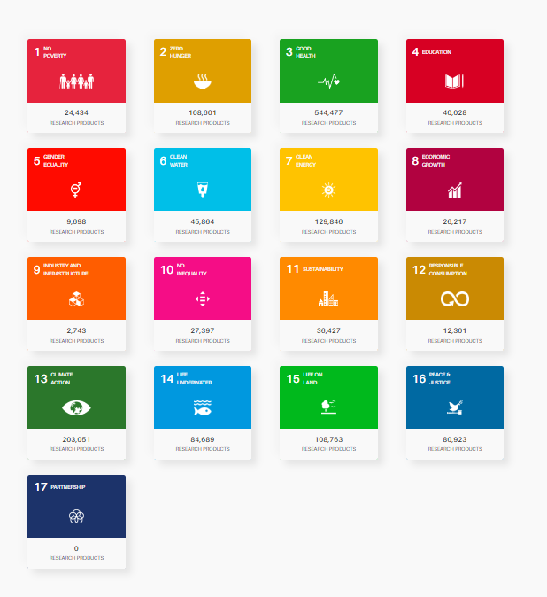
… the research output
OpenAIRE publishes summary information about the SDGs in the research outputs
  This is lagging
  Only reflects the research projects with output
  Obtained using a blackbox ML approach (Scinobo)
Limited flexibility for research funding effectiveness evaluation
  Drilldown to targets
  Connections between SDGs

Slide 9

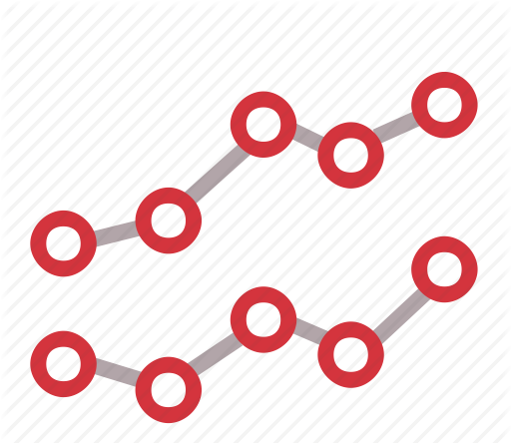

The research gap that we aim to fill
Compute
Aggregate
Study
Project2SDG
(Cordis: funded)
(eCorda: all proposals)
SDG2Insights
Attention to SDGs
Research potential of SDGs

Slide 10
Desired characteristics ➔ Choices of methodology
Consistent over time
Tractable
Explainable
Dictionary-based approach
Many SDG lexicons exist, we took the one from the European Commission, developed by Borghardt et al. (2022) mapping all the EU Policies to the SDGs and its targets.
This lexicon was created through a rigorous, iterative process in which SDG experts identify terms. These are used to look for policy documents. Refinements are made if term is not frequently found or results in the retrieval or irrelevant documents.
Widely accepted
Fit for purpose
Not reinventing the wheel

Slide 11
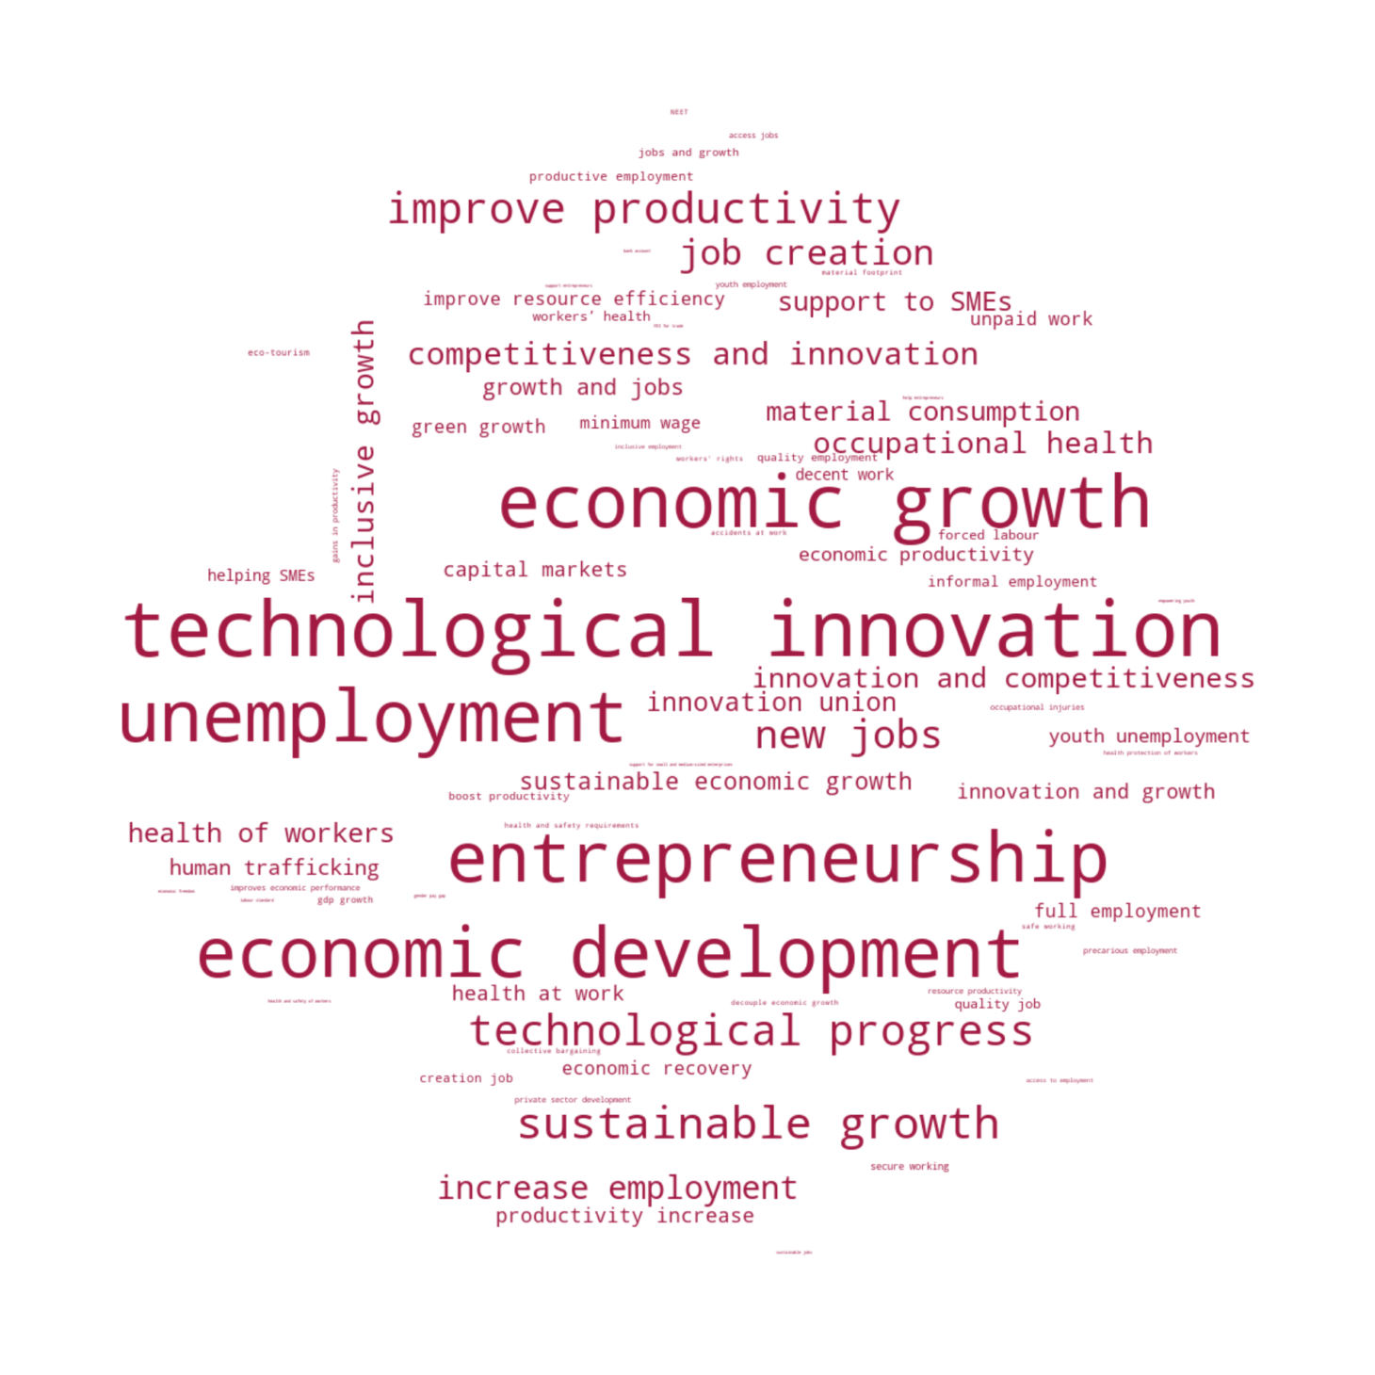
EC’s SDG8 lexicon
Targets | Indicators | Lexicon Keywords
8.0 Sustainable Development Goal 8 |  | Sustainable Development Goal 8, SDG 8, sustainable economic growth, repair labour markets, boost jobs and growth, protect workers and jobs, economic recovery
8.1 Sustain per capita economic growth in accordance with national circumstances and, in particular, at least 7 per cent gross domestic product growth per annum in the least developed countries. | 8.1.1 Annual growth rate of real GDP per capita | economic growth, economic development, gdp growth, growth rate of real gdp, growth rate of gdp, gross domestic product growth, gross added value, growth and jobs, inclusive growth, sustainable growth, productive sectors growth
8.2 Achieve higher levels of economic productivity through diversification, technological upgrading and innovation, including through a focus on high-value added and labour-intensive sectors. | 8.2.1 Annual growth rate of real GDP per employed person. | economic productivity, technological innovation, innovation union, technological progress, innovation and growth, competitiveness and innovation, innovation and competitiveness, improves economic performance, gains in productivity, boost productivity, improve productivity, productivity increase
8.3 Promote development-oriented policies that support productive activities, decent job creation, entrepreneurship, creativity and innovation, and encourage the formalization and growth of micro-, small- and medium-sized enterprises, including through access to financial services. | 8.3.1 Proportion of informal employment in total employment, by sector and sex. | job creation, creates quality jobs, entrepreneurship, support entrepreneurs, support productive activities, non‑agriculture employment, increase employment, new jobs, finance for enterprises, jobs and growth, creation job, encourage enterprises to be innovative, support for small and medium-sized enterprises, helping SMEs, help small and medium-sized enterprises, support to SMEs, creative jobs, sustainable jobs, emerging industry jobs, jobs in innovative sectors, access jobs, job-rich recovery, workers living in extreme poverty, stimulate business environment, stimulate investment climate, stimulate business climate, Ease of Doing Business Index, economic freedom, support to Micro, Small and Medium Enterprises, support to MSME, private sectors organizations promotion, private sector development, supporting private SMEs, private sector advocacy, capital markets, regulatory framework for SMEs development, help entrepreneurs, create business climate, create business environment, create investment climate, support innovation of SMEs, support innovation of enterprise, support innovation of Small and medium sized
8.4 Improve progressively, through 2030, global resource efficiency in consumption and production and endeavour to decouple economic growth from environmental degradation, in accordance with the 10-year framework of programmes on sustainable consumption and production, with developed countries taking the lead. | 8.4.1 Material footprint, material footprint per capita, and material footprint per GDP. | decouple economic growth, improve resource efficiency, material footprint, material consumption, resource productivity, green growth, climate-resilient growth, economic growth decoupled from resource use, resource efficiency in consumption and production
 | 8.4.2 Domestic material consumption, domestic material consumption per capita, and domestic material consumption per GDP.
8.5 By 2030, achieve full and productive employment and decent work for all women and men, including for young people and persons with disabilities, and equal pay for work of equal value. | 8.5.1 Average hourly earnings of employees, by sex, age, occupation and persons with disabilities. | full employment, productive employment, decent work, unemployment, inclusive employment, equal pay, high-skilled employment, help most vulnerable to return to the labour, quality employment, minimum wage, fair working conditions, gender pay gap, gender balanced labour market, decent job, inclusive job, quality job, job creation for the most vulnerable, creation of job opportunities, decent labour, protecting jobs, women participation in the labour force, informal employment, underutilized women in the labour force, help women make steady incomes, vocational rehabilitation, employment of people with disabilities, recruitment of persons with disabilities, Decent employment, access to employment, unpaid work, underutilised women in the labour force, poor job search skills
 | 8.5.2 Unemployment rate, by sex, age and persons with disabilities.

Slide 12
A simple rule
A project has attention for a SDG if at least one of the words in that SDG dictionary is present in the title or abstract
This implies that we can have projects with no SDGs (language is high-dimensional, dictionary size is limited), and projects with multiple SDGs
 | FP1 | FP2 | FP3 | FP4 | FP5 | FP6 | FP7 | H2020 | HE
No SDG | 69.75 | 66.28 | 58.51 | 61.36 | 62.91 | 61.77 | 63.72 | 58.64 | 52.13
Multiple SDGs | 4.57 | 5.3 | 9.4 | 10.36 | 7.94 | 10.02 | 9.47 | 13.34 | 18.93

Slide 13
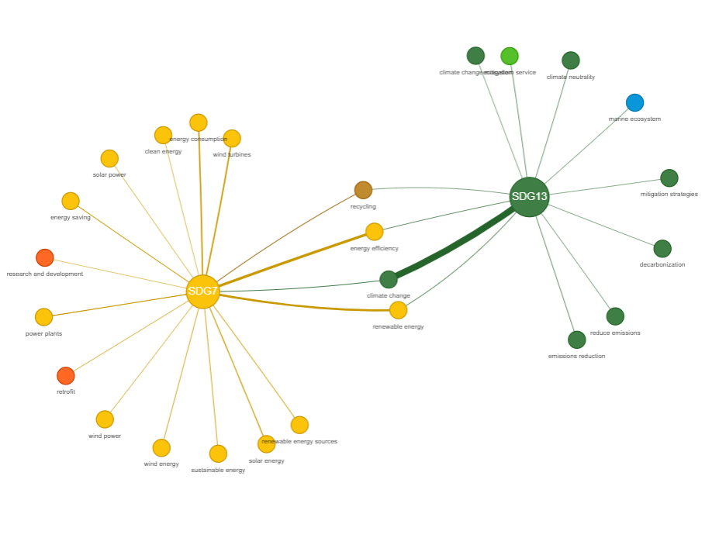
Network plot to see the overlap between SDGs
SDG 13: Climate action
SDG 7: Affordable and clean energy

Slide 14
Absolute vs Relative Prevalance

Slide 15
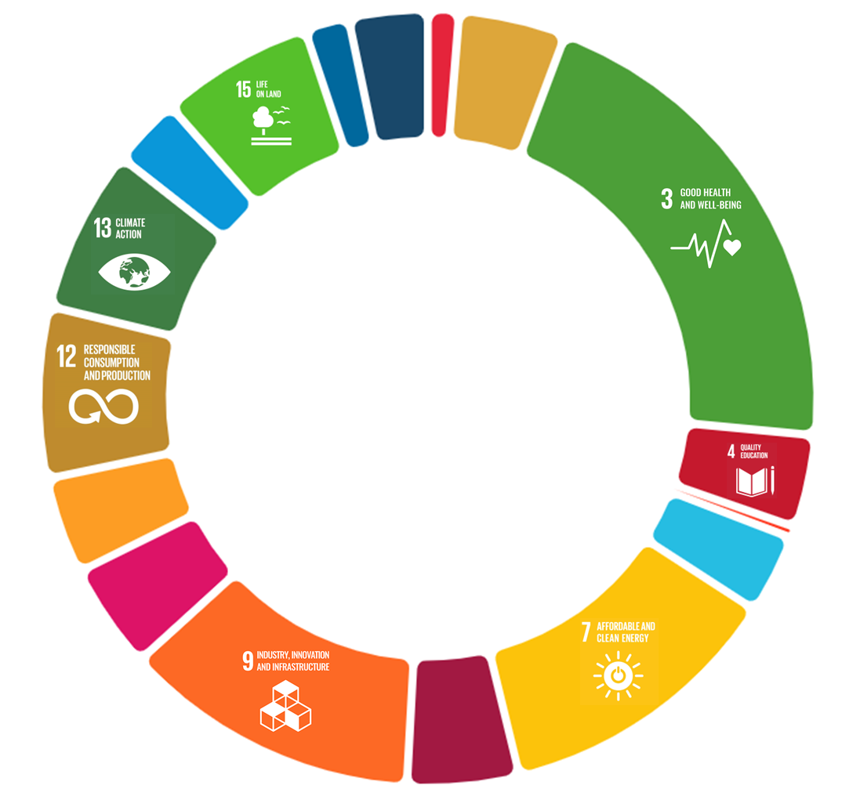
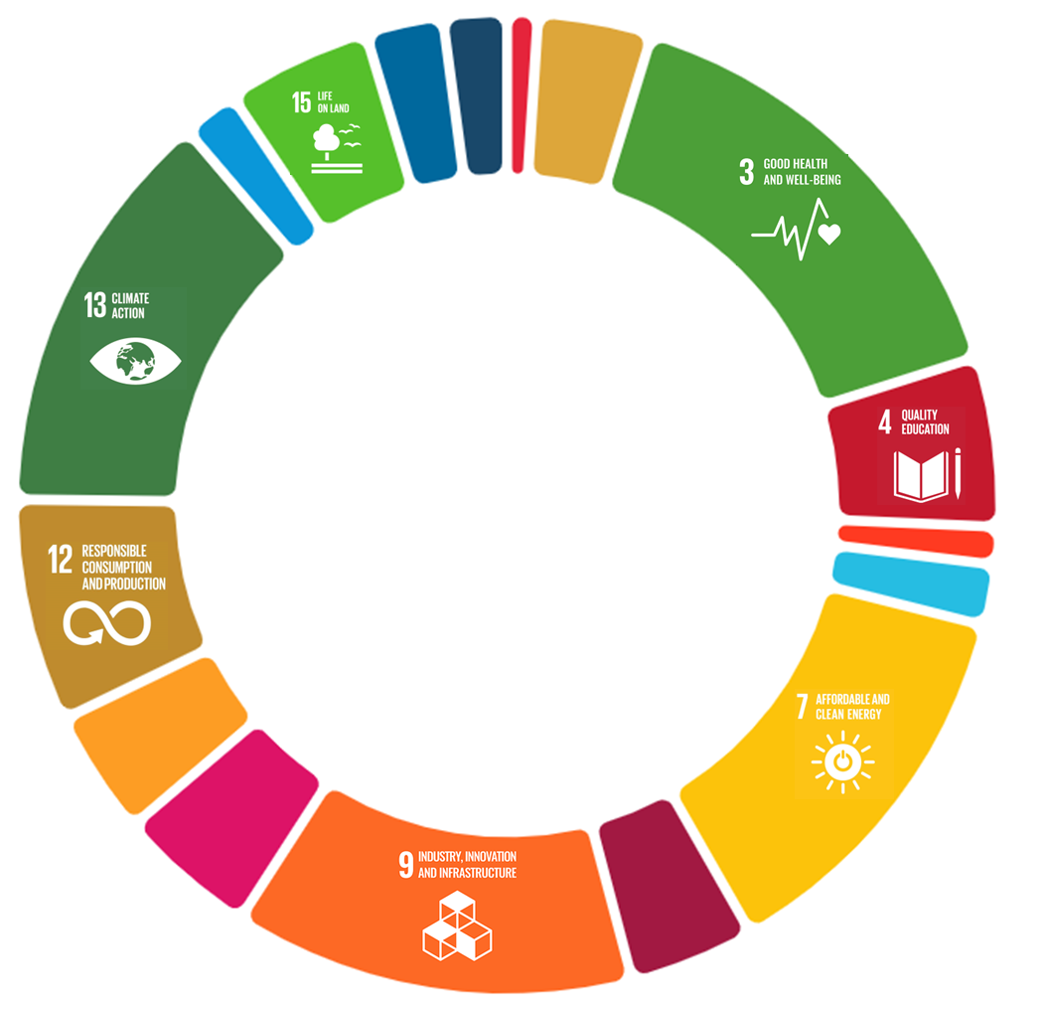

The SDG wheel of EU research funding
Averaged across FP1 – Horizon Europe
Horizon Europe (till Nov 2023)

Slide 16
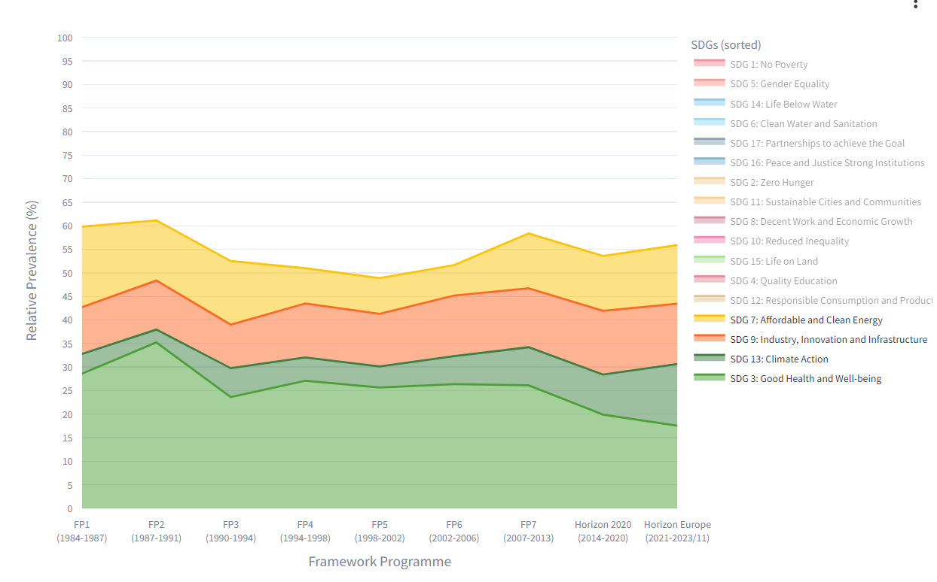
Relative prevalence table
Concentration and time-variation.

Slide 17
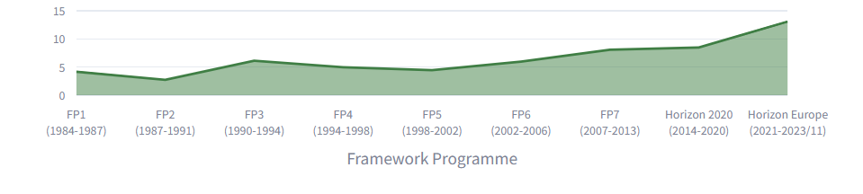
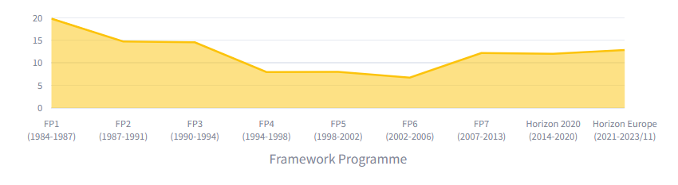
SDG 13: Climate action. SDG 7: Affordable and clean energy

Slide 18
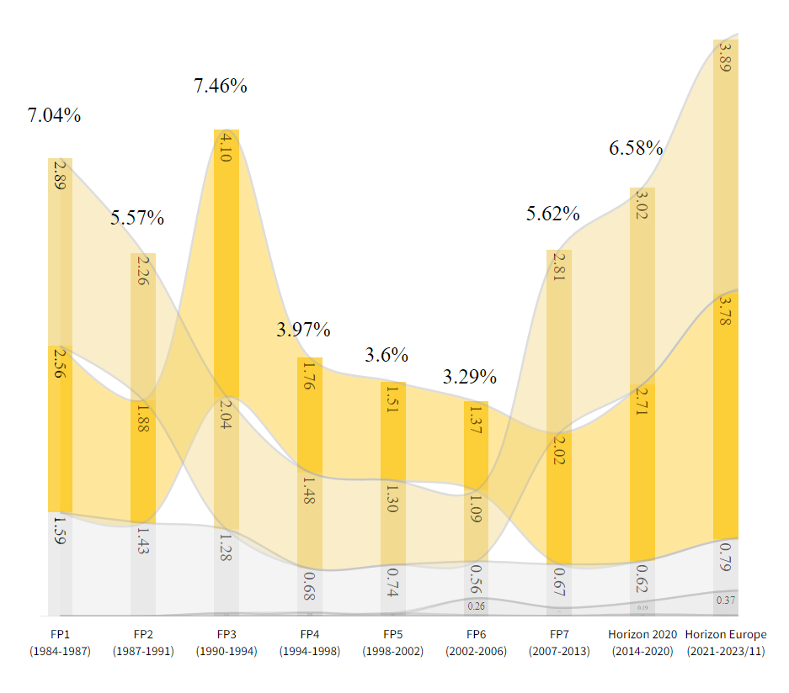
Steam chart
7.3 By 2030, double the global rate of improvement in energy efficiency.
7.2 By 2030, increase substantially the share of renewable energy in the global energy mix.

Slide 19
Project2SDG, SDG2Insights
So far we have been monitoring: SDGs are not funded equally
The obtained numbers are a starting point of a discussion
  Consistent with policy objectives?
  Action needed?
The numbers are also a starting point for further research on causes and effects

Slide 20
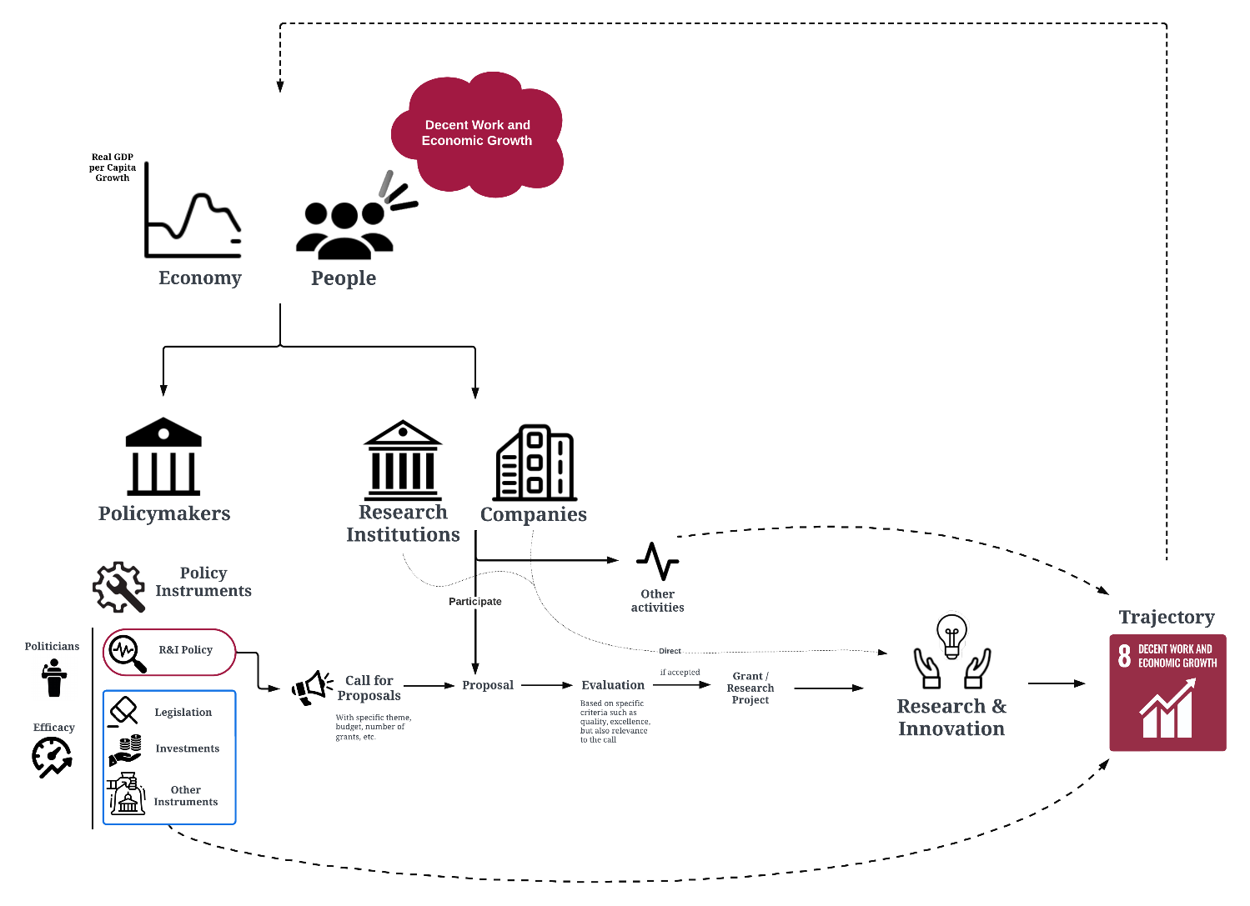
A first explorative, predictive analysis
Does research react to the performance of the indicator?
Test in the context of SDG 8 – promote sustained economic growth, full and productive employment, and decent work for all

Slide 21
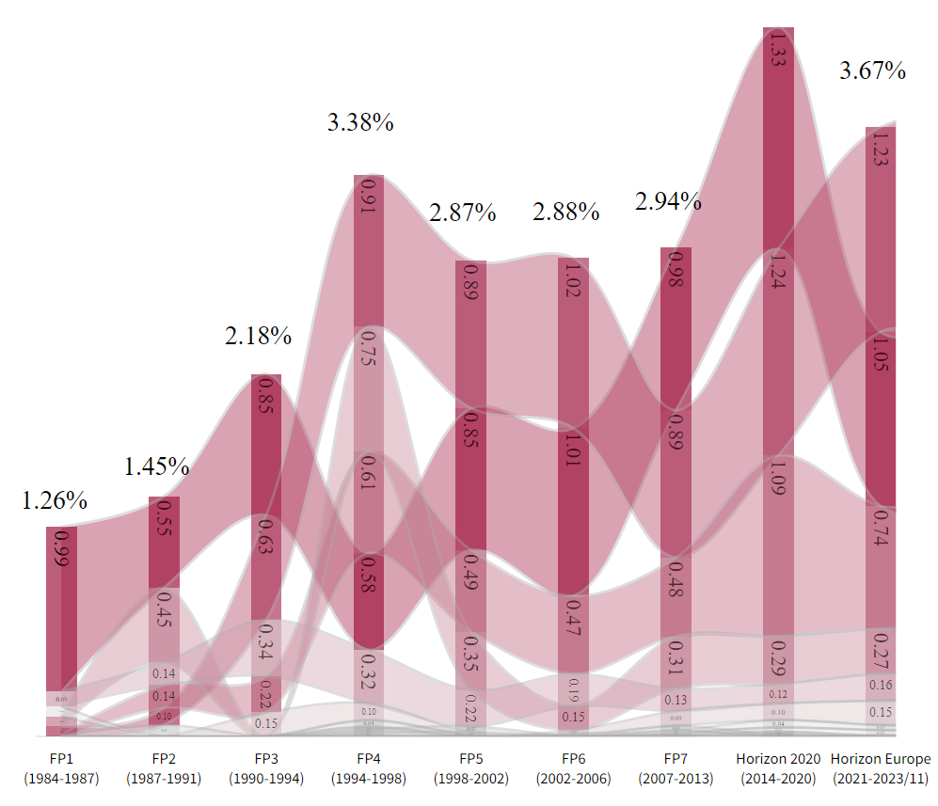
8.1 Sustain per capita economic growth
Indicator is economic growth
8.2 Achieve higher levels of economic productivity
Indicator is real GDP per capita
8.5 Full and decent employment
Indicator is unemployment

Slide 22
Results

Slide 23
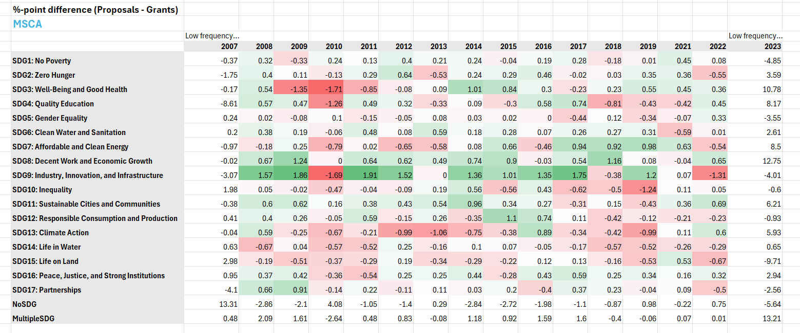
Current research: Combine proposals and funded

Slide 24
Conclusion
  100,000+ grants funded
  How to summarize them using 17 meaningful dimensions?

Slide 25
We hope you liked the approach and look forward to more research exploring the heterogeneity of SDG attention in EU project proposals
https://sdgdashboard.streamlit.app
Boudt, K., Inghels, Y., & Spithoven, A. (2024). Trac (k) ing the trajectory: Mapping Sustainable Development Goal 8 in EU-funded research projects (No. 24/1084). Ghent University, Faculty of Economics and Business Administration.

