Slide 1
Science, Technology and Innovation in a new geopolitical landscape: a wake-up call for Europe Luc Soete
MERI-BELSPO Conference on R&D, innovation, sustainability and the societal impact of new technologies under the Belgian Presidency of the European Council, Brussels, 25 April 2024

Slide 2
STI contributing to sustainable development
Delighted to be here. Last time I attended a BELSPO conference (Leuven, September 2019), it was about the future of the ERA.
Focus was then on the openness of the ERA to the world… “in the light of the transformation of China into a superpower in the field of research and innovation and its consequence on the European research and innovation landscape and policies…” Reinhilde Veugelers also attended.
As one of the older, now retired R&I experts, my first reaction would be: finally, full recognition of the crucial role of STI for EU competitiveness (Lisbon), for MS (Barcelona targets) and for regions (S3 conditionality).
Within the new framework of the European Green Deal, the talk is no longer about soft “open methods of coordination” but now on “competitive sustainability” within a common regulatory framework set up by the EC: Net-zero Industrial Plan, CRM Act, Chips Act, etc.
Do we have the right indicators to monitor, do we have the right incentives for firms to implement… Focus of much of the discussions here.

Slide 3
Five years later, it’s all about implementation
R&I is still underfunded in Europe particularly by the private sector, compared to US and China, and is particularly the case in areas where market upscaling is an issue...
So contrary to what was hoped for, sustainability in Europe as opposed to the US or China, did not translate itself into “competitiveness”…
A new industrial strategy is now being proposed by the EC based on “Open Strategic Autonomy” and a strengthening of Europe’s technological sovereignty.
Two questions arise:
- “Open” R&I was a European quality as in open science, in setting global research standards, in international research collaborations, in global value chains. How will this be the case in an ‘open strategic autonomy’ world?
- Most foreign technological dependency has been self-inflicted.

Slide 4
So, a first question:
Can Europe have an “Open” industrial policy? Is an industrial policy at EU-level actually “feasible”?
Look at the first results of the Chips Act with the emergence of new industrial chips manufacturing clusters in fiscally powerful regions (Silicon Saxony).
Look at what Ricardo Hausmann described as the end of the fossil fuel “flat world” and the potential implications for the industrial re-location of energy-intensive industries: “energy based on fossil fuels have as unique feature the fact that they are amazingly energetic per unit of volume and weight. Combined with advances in transportation technologies, it made the world “flat” from an energy point of view: absence of local energy sources was no longer an obstacle… In a decarbonizing world, … energy-intensive activities will again have to take place near specific locations just as in the days of waterwheels.”“
The heavy investments by individual member states in renewable based electricity grids or green hydrogen pipelines appears sometimes inspired by attempts at bringing renewable energy to now, poorly located energy intensive industrial clusters.
Place becomes again an important differentiating energy cost factor.

Slide 5
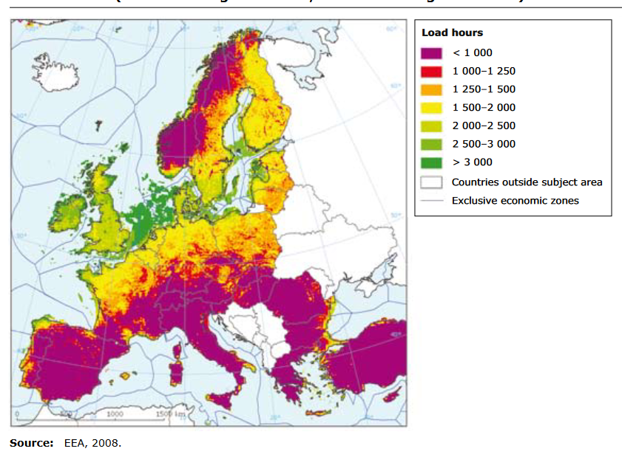
Distribution of wind velocity in Europe

Slide 6
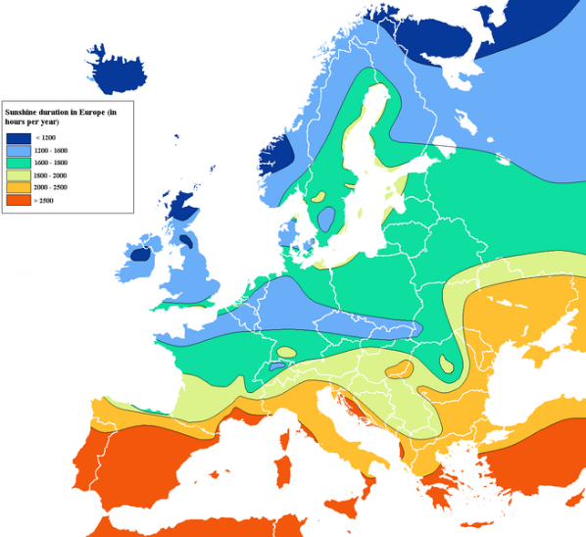
Sunshine duration in Europe

Slide 7
Second question: strategic autonomy
Strategic autonomy inspired by a need to de-risk and create resilience in Europe’s (global) value chains with the aim of strengthening the global competitiveness of European industry.
Transformations hit though places differently: not just in case of energy transition from fossil fuels to renewable energy, but also in live-stock farming, in widespread application of circular economy principles and subsequent shifting demands for land use, housing, mobility, public transport.
All these will create pressures to reallocate industries, putting some territories under stress with active population having to emigrate (growth of large cities), forced to adjust to changing external environment in which they have no say.
Overall, territorial effects of the accelerating climate change and declining biodiversity will trigger further additional stress with several territories suffering from water scarcity, wildfires, loss of biodiversity or flooding.

Slide 8
From ERA to EDRIA
Resilience, de-risking and “economic security” have been proposed as new policy aims. But economic security is a tricky concept: security makes sense from a military/defence or social/income perspective. Applied to economics, it remains very much open to debate… it could even be used to counter some of the creative destruction features of R&I, reflecting incumbents’ interests.
Why not introduce “security” as a new European policy aim in its real sense, part of well-being and of fairness? In short, enlarge R&I policy to include also security, allowing for dual use technologies, establish a European Defence Research and Innovation Area (EDRIA) allowing on the one side for more radical R&I breakthroughs and on the other side for greater demand procurement.
Doing so security fits also much more the notion of missions.

Slide 9
Territorial security as new cohesion aim
The geographical concentration of particular defence production in Europe grew out of individual member states to allocate defence budgets to places often in border regions and in the periphery of the country. Many of such earlier defence-oriented industrial policies could, in retrospect be considered as national “cohesion” policy tools avant la lettre.
They offer now a new role for European cohesion policies: contributing to Europe’s security.
It is in this sense that “territorial security” can be considered as a new European and member states’ policy aim: one which repositions cohesion policy as a policy which has alongside regional structural transformation, a broader European security purpose benefiting all MS and justifying the financial contributions and transfers from more centrally located member states and regions.

Slide 10
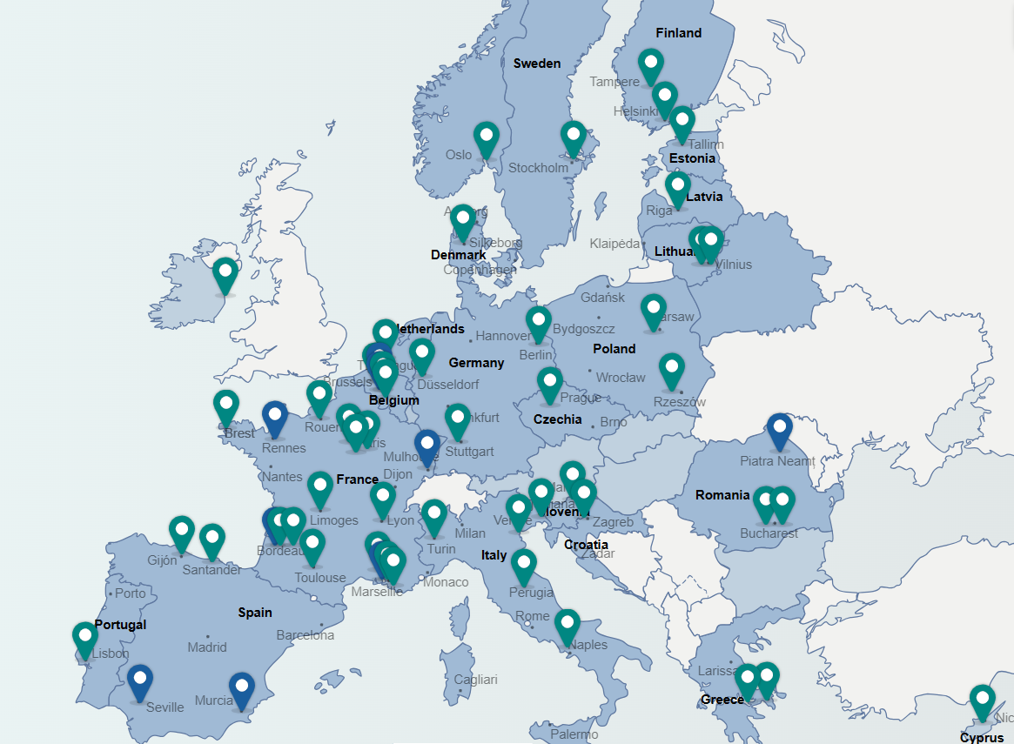

Slide 11
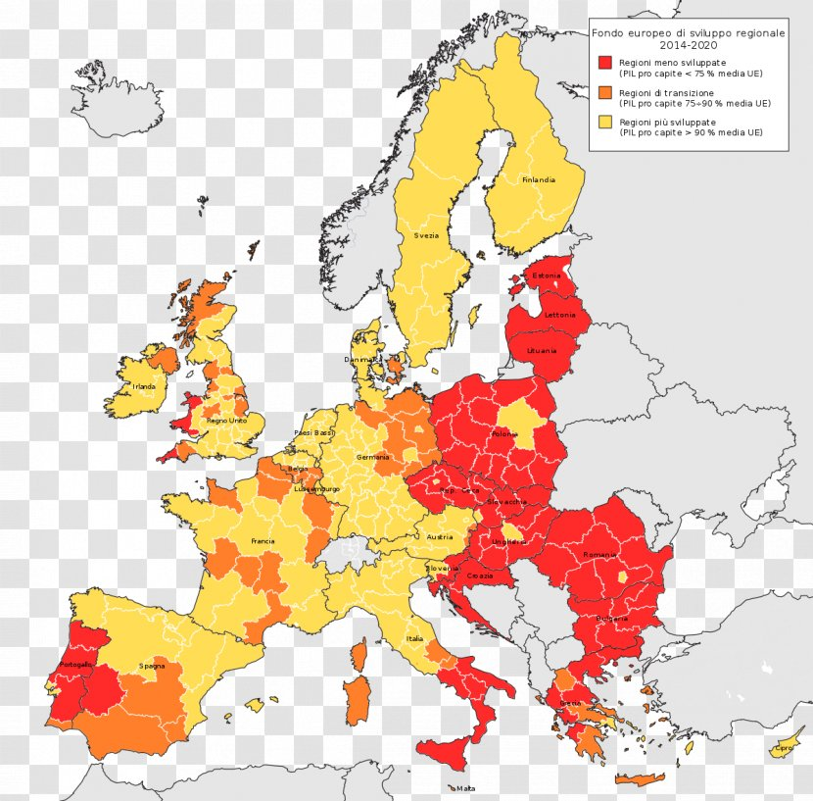

Slide 12
A concluding “after” thought
Our reliance on scale economies as opposed to portfolios of more granular technologies should be thought over. It could be said to have led to an alignment between incumbents & regulatory frameworks making more lumpy technologies politically more attractive.
Isn’t it time to open the diversity of applications of more granular technologies… which vary in scale, heterogeneous applications, involve a greater diversity of firms and users.
These could also be associated with faster diffusion, lower investment risk, more opportunities to escape lock-in, more equitable access, and higher social returns on innovation investment.
By enabling smaller increments of capital investment, more-granular technologies de-risk R&D and Demonstration portfolios opening markets to the destabilizing force of new entrants.

Slide 13
Thank you
l.soete@maastrichtuniversity.nl

