Slide 1
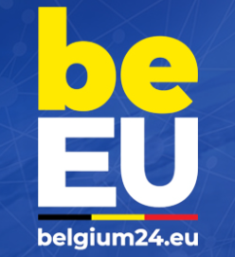
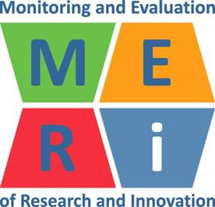
Belgian presidency Council of the European Union
MERI-BELSPO Conference – 25 April 2024
Innovation and sustainability: Rethinking economic policies for the future
Michele.Cincera@ulb.be

Slide 2
AGENDA
1. Introduction: Understanding innovation and sustainability
2. RDI performance and SDG progress
3. RDI and sustainability policies
4. SDGs: Challenges and opportunities
5. Rethinking RDI policies for SDGs
6. Conclusion and future directions

Slide 3
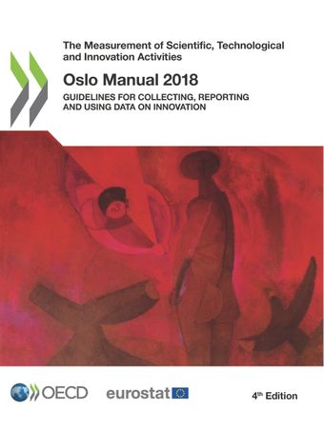
1. Understanding Innovation and Sustainability
“An innovation is a new or improved product or process (or combination thereof) that differs significantly from the unit’s previous products and processes and that has been made available to potential users (products) or brought into use by the unit (process).”

Slide 4
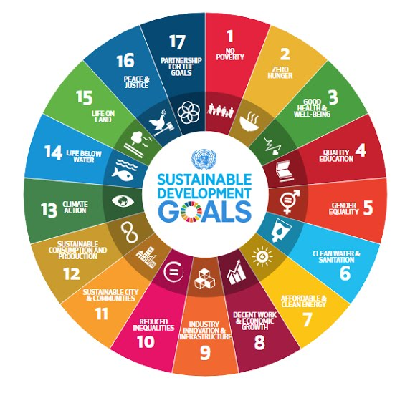
1. Understanding Innovation and Sustainability
In 1987, the United Nations Brundtland Commission defined sustainability as “meeting the needs of the present without compromising the ability of future generations to meet their own needs.” Today, there are almost 140 developing countries in the world seeking ways of meeting their development needs, but with the increasing threat of climate change, concrete efforts must be made to ensure development today does not negatively affect future generations.

Slide 5
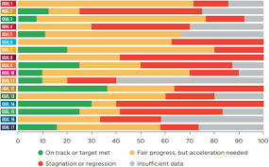
SDG Progress at a Glance
A concerning picture of SDG progress at the midpoint:
48
%
On Track
Moderately or Severely Off Track
15
%
37
%
Stagnation or Regression
Source: The Sustainable Development Goals Progress Chart 2023

Slide 6
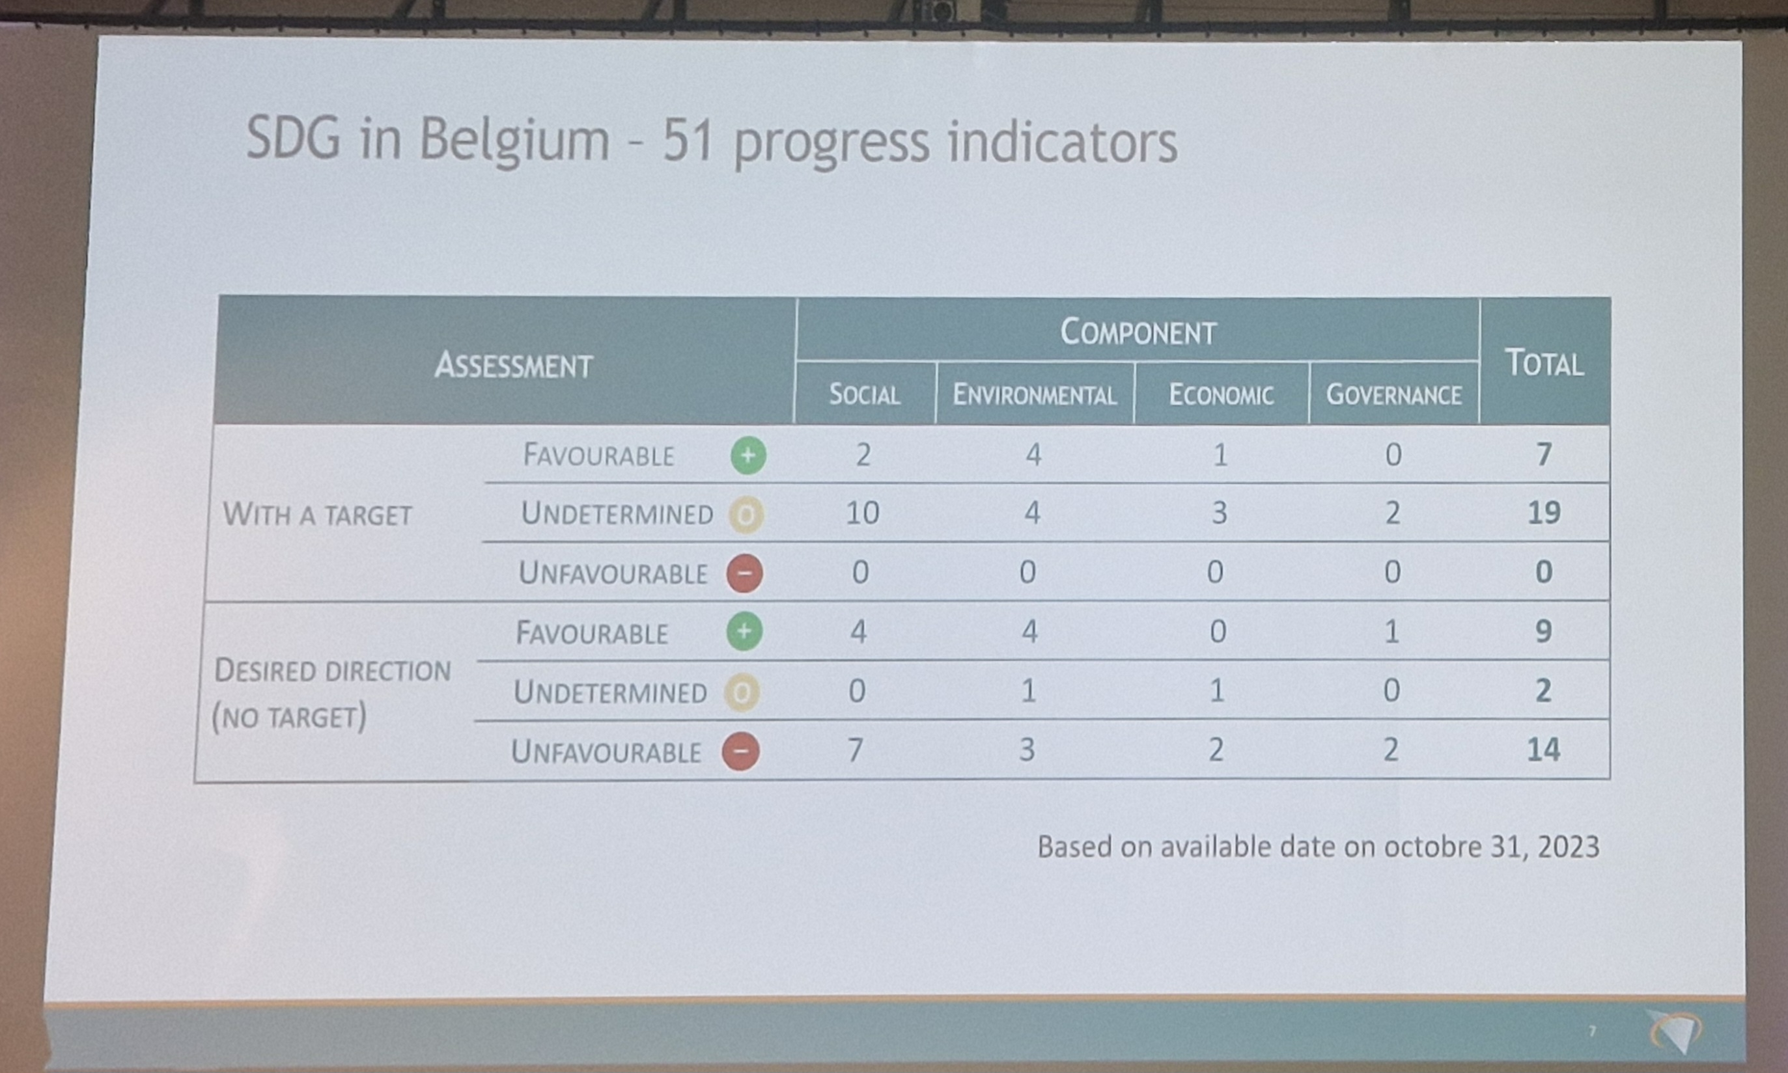
SDG Alain Henry
Source: BELSPO

Slide 7
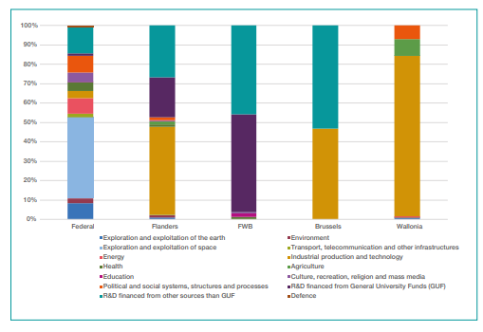
SDG Progress at a Glance GBARD breakdown by socio-economic objective
Source: BELSPO

Slide 8
GERD: within the EU (as a % of GDP)
Source: Eurostat

Slide 9
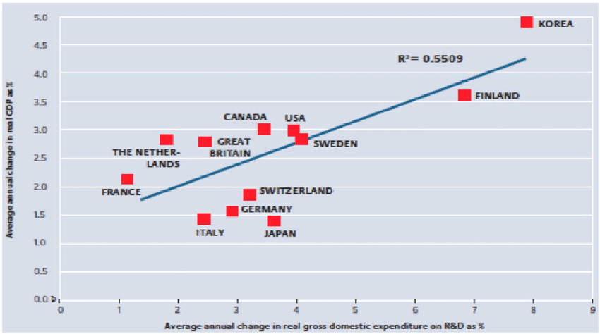
Performance of RDI
Positive relationship between R&D and economic growth
Source: German Federal Ministry of Education and Research (2010)

Slide 10
Innovation Output Indicator, 2011 and 2020
Note: The Innovation Output Indicator aggregates four components: patents, employment in knowledge-intensive activities, trade in knowledge-based goods and services, and innovativeness of high-growth enterprises.
Source: EC 2022

Slide 11
Knowledge valorisation approach, latest available year
Source: EC 2022

Slide 12
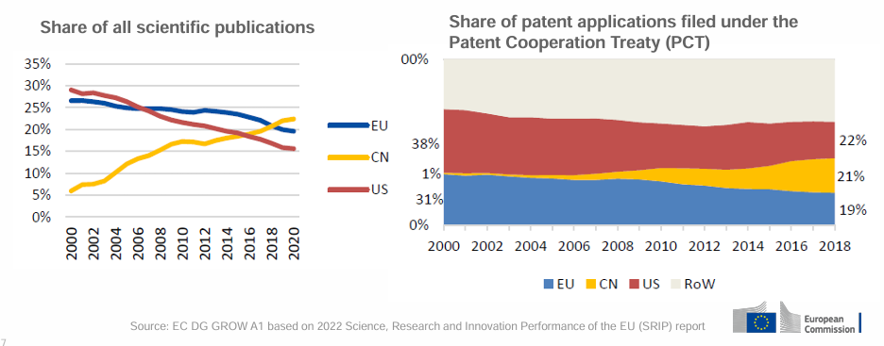

Slide 13
3. RDI policies and sustainability
https://www.belspo.be/belspo/organisation/publ/pub_ostc/BRISTI/FWB_rapport_2021_en.pdf

Slide 14
Direct government funding and tax support for business R&D, As a percentage of GDP, 2019
Source: OECD R&D Tax Incentives Database

Slide 15
Broad socio-political objectives of the Von Der Leyen Commission (2021-2024)
A European Green Deal
Europe aims to be the first climate-neutral continent by becoming a modern, resource-efficient economy
A Europe fit for the digital age
The EU’s digital strategy will empower people with a new generation of technologies
An economy that works for people
The EU must create attractive investment environment, and growth that creates quality jobs, especially for young people and small businesses
A stronger Europe in the world
The EU will strengthen its voice in the world by championing multilateralism and rules-based global order
Promoting our European way of life
Europe must protect the rule of law if it is to stand up for justice and the EU’s core values
A new push for European democracy
We need to give Europeans a bigger say and protect our democracy from external interference such as disinformation and online hate messages

Slide 16
Horizon Europe (2021-2027)
The EU provides (financial) support to R&I projects via a seven-year “Framework Programme for Research and Innovation”
Objectives are to nurture excellence in research and turn this excellence into leadership in innovation and solutions for addressing societal challenges (UN SDGs)

Slide 17
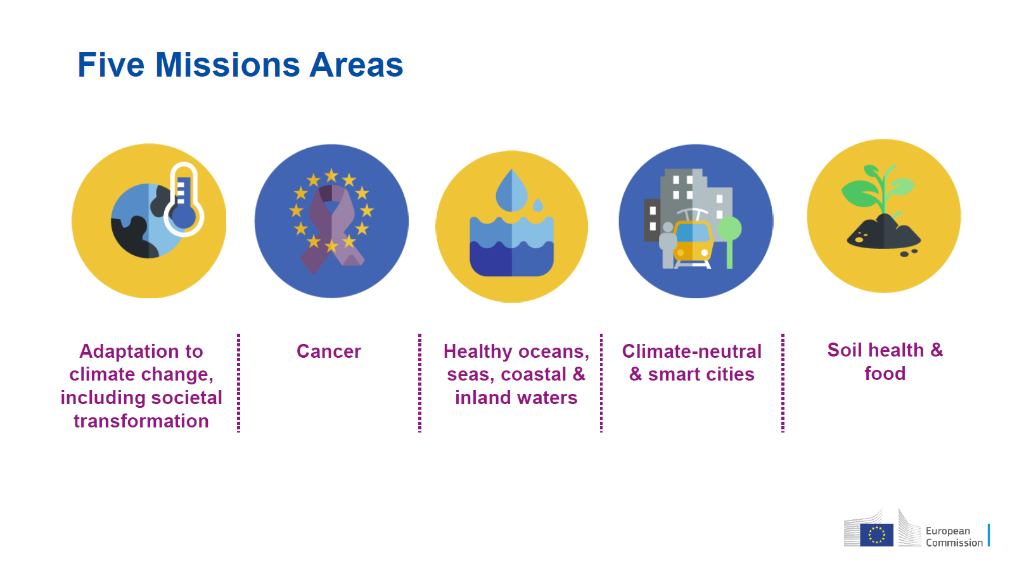
Mission-oriented Research & Innovation Policy
What are mission-oriented R&I policy?
EU Mission in Horizon Europe (2021-2027)
“initiatives [which] typically are ambitious, exploratory and ground-breaking in nature, often cross-disciplinary, targeting a concrete problem/challenge, with a large impact and well-defined timeframe. More specifically, they have a clearly defined (societal and technological) goal with preferably qualified and/or quantified targets and progress monitored along predefined milestones. Directionality and intentionality of these initiatives is what differentiate them from other types of initiatives, such as systemic or challenge-oriented policies” (JIIP et al., 2018)

Slide 18
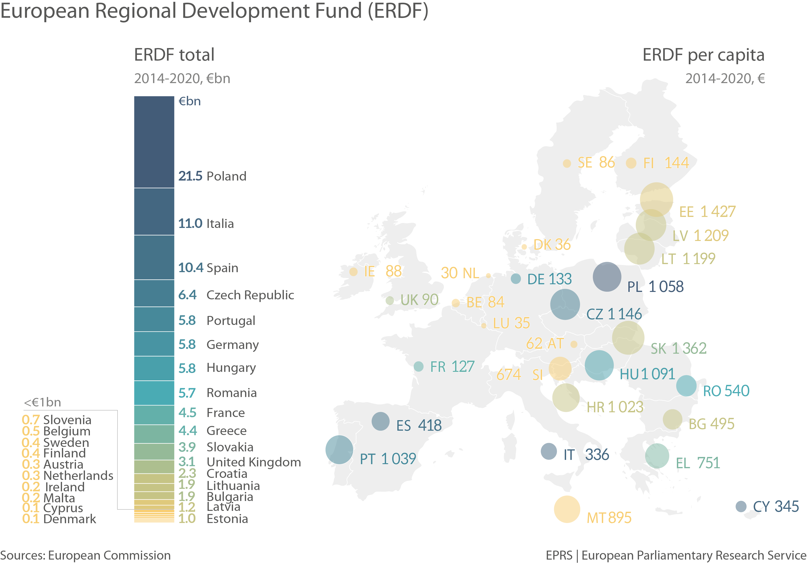
ERDF (2014-2020)

Slide 19
Current RDI and sustainability policies (EU and Belgian level)
SDGs and POLICY-MAKING IN BELGIUM
At the Federal level, at the Ministerial Council of 24 July 2015, a memorandum regarding the division of tasks for the preparation and follow-up of the Sustainable Development Goals (SDGs) was approved.
This memorandum stipulates that the federal monitoring and implementation in Belgium is to be carried out from the sphere of competence of sustainable development.
Concerning the follow-up at the European and international level, the responsibility lies at the Minister of Foreign Affairs and the Minister for Development Cooperation.
Five lines of action were drawn up by the Federal Institute for Sustainable Development (FISD) in consultation with Minister Marghem (Minister for Sustainable Development). These lines of action serve as a first structured step; however these will be further expanded and modified in the coming 15 years.
Make SDGs known to civil society
Updating and integration of the sdgs in the existing structures of the federal strategy on sustainable development
The implementation of the sdgs via the operation and the policy of the federal public services
The improvement of the coherence between the different policy levels (nssd)
Establishing partnerships

Slide 20
4. SDGs: Challenges and Opportunities
SWOT
Strenghts:
* Environmental protection
* Economic opportunities
* Social equity
* Long term benefits
Weaknesses:
* Initial costs
* Resistance to change
* Policy fragmentation
* Trade-offs
Opportunities:
* Technological innovation
* International cooperation
* Public awareness
* Policy integration
Threats:
* Political instability
* Economic pressure
* Ressource scarcity
* Climate change impacts

Slide 21
5. Rethinking RDI Policies to align and contribute to achieve SDGs
Integration of SDGs into RDI Strategies: Governments, research institutions, and funding agencies should integrate the SDGs into their RDI strategies, ensuring that research and innovation efforts are aligned with sustainable development objectives.
Multi-stakeholder Collaboration: Foster collaboration among governments, academia, industry, civil society, and international organizations (quintuple helix model!) to address complex sustainability challenges through RDI initiatives. Multi-stakeholder partnerships can leverage diverse expertise, resources, and perspectives to develop innovative solutions.
Interdisciplinary Research: Encourage interdisciplinary research approaches that transcend traditional disciplinary boundaries to address interconnected sustainability issues. Integrating perspectives from various fields such as science, technology, social sciences, and humanities can lead to holistic solutions.
Focus on Impact and Societal Relevance: Prioritize RDI projects that have a tangible impact on addressing societal challenges and contribute directly to the achievement of specific SDGs. Emphasize research with clear pathways to implementation and scalability.

Slide 22
5. Rethinking RDI Policies to align and contribute to achieve SDGs
Question: Based on lessons learned from the previous programming periods, what role should ERDF play in Cohesion Policy post-2027 to support RTDI to undergo the green and digital transition?
Based on previous programming periods, the next ERDF should increasingly act as a catalyst in Cohesion Policy to foster RDI RTDI to undergo the green and digital transition
This could be achieved by targeted investments that directly enhance infrastructure and capacities for the green and digital transitions. Examples: Renewable Energy Infrastructure, Smart Grids, Electric Vehicle Charging Infrastructure, Energy-Efficient Buildings, Digital Connectivity, Data Centers and Cloud Computing, Research and Innovation Hubs, Waste Management Infrastructure, Water Infrastructure, Green Public Transportation,…
Also, the focus should be on high-impact projects that integrate sustainable practices and digital technologies. Examples: Smart Cities Initiatives, Precision Agriculture, Circular Economy Platforms, Energy-Efficient Manufacturing: Implementing digital technologies such as Industrial Internet of Things (IIoT), machine learning, and robotics in manufacturing processes to improve energy efficiency, reduce waste, and optimize production,…
Doing so the ERDF can drive significant advancements in both environmental sustainability and technological innovation.
This will ensure that regions across Europe are not only interconnected but are also forward-looking and resilient in facing future challenges.

Slide 23
5. Rethinking RDI Policies to align and contribute to achieve SDGs
Capacity Building and Knowledge Sharing: Invest in building research and innovation capacities to empower local communities to address their sustainability challenges. Facilitate knowledge sharing and technology transfer to ensure that innovations reach those who need them the most.
Ethical Considerations: Integrate ethical considerations into RDI policies and practices to ensure that research and innovation activities are conducted responsibly and ethically, respecting human rights, cultural diversity, and environmental sustainability.
Incentive Mechanisms: Develop incentive mechanisms, such as funding opportunities, awards, and recognition, to incentivize researchers, innovators, and institutions to prioritize projects that contribute to the SDGs. Align funding criteria with sustainability objectives to steer RDI efforts towards societal impact.
Monitoring and Evaluation: Establish robust monitoring and evaluation frameworks to assess the effectiveness and impact of RDI policies and initiatives in contributing to the achievement of the SDGs. Regularly track progress, identify gaps, and adapt strategies accordingly.

Slide 24
6. Conclusion and Future Directions
Simplify RDI state aids rules
Align and streamline funding processes of policy instruments and programmes
Increase public funding for RDI, e.g. public technological procurement
Mission oriented (SDGs societal goals)
Ensure that RTDI projects are not only innovative, but also aligned with the overarching goals of sustainable and inclusive growth in the EU.

Slide 25
Thank you for your attention !
Michele.Cincera@ulb.be

