Slide 1
Sustainable and inclusive wellbeing: an integrated approach to measure wellbeing ‘beyond GDP’
The road forward
Peter Benczur, EC JRC
April 2024
The views expressed are those of the presenter and do not necessarily reflect the official view of the European Commission.

Slide 2
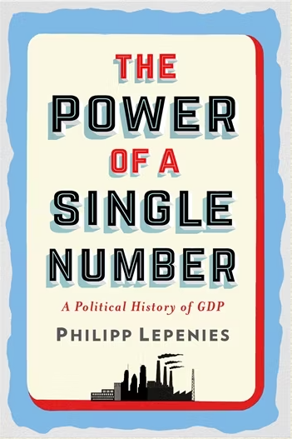
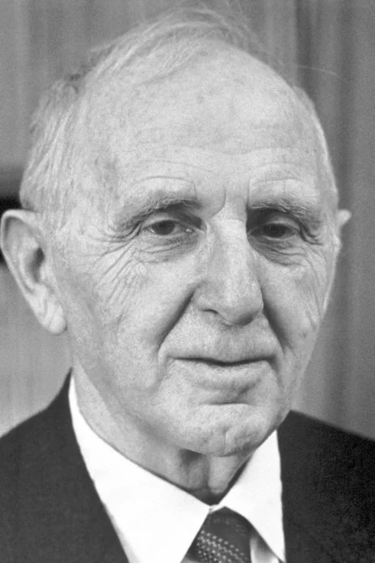
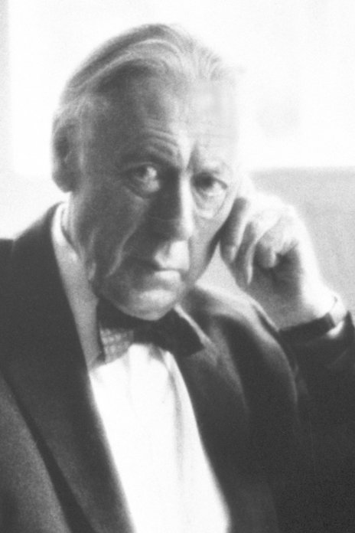
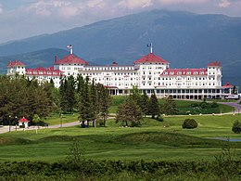
GDP: back to 1944
Simon Kuznets, 1934
Photo from the Nobel Foundation archive.
Richard Stone, 1953
Photo from the Nobel Foundation archive.
Bretton Woods, 1944

Slide 3
Reasons to “adjust” GDP
  Internal:
    Measuring non-market activities
    Measuring the benefits of major aspects of technological change
  External:
    Non-monetary aspects of wellbeing
    Distributional issues
    Sustainability (climate, environment, material overuse

Slide 4
The history of going ‘beyond GDP’
1968 US Senator Robert Kennedy’s famous speech where he says GDP “measures everything except that which makes life worthwhile”
1971 Bhutan starts to measure its progress using a Gross National Happiness Index
2004 First OECD World Forum on Key Indicators (Palermo)
2007 Second World Forum: the Istanbul Declaration on Measuring Social Progress
2008-09 commissioned by French President Sarkozy, the work of the first Stiglitz-Sen-Fitoussi Commission and their report on the ‘Measurement of Economic Performance and Social Progress’
2009 EC Communication: ‘GDP and beyond: measuring progress in a changing world’
2011 launch of the OECD’s Better Life Index and How’s life series
2019 New Zealand delivers a first ‘wellbeing budget’

Slide 5
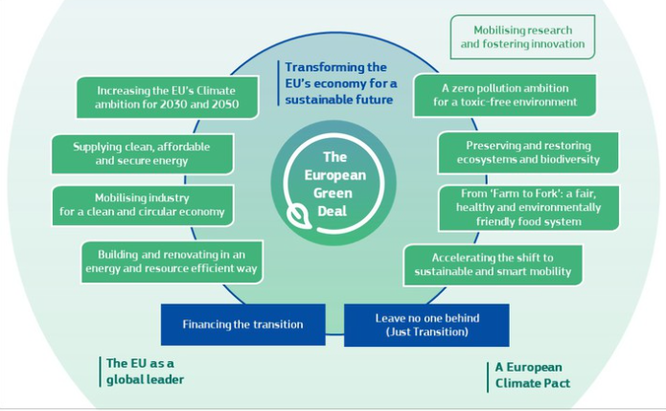

The European Green Deal and post-COVID

Slide 6
Elements of the political momentum in the EU
Porto declaration (2021)
  “…alternative set of indicators to measure economic, social and environmental progress, supplementing GDP as welfare measure for inclusive and sustainable growth.”
Conference on the Future of Europe (2022)
  “…conventional macroeconomic indicators and the GDP could be complemented with new indicators in order to address the new European priorities such as the European Green Deal or the European Pillar of Social Rights and to better reflect the ecological and digital transitions and the wellbeing of people;”
8th EAP (2022)
  “developing a summary dashboard and indicator set measuring 'beyond GDP', based on, inter alia, a targeted consultation with all relevant stakeholders as well as a report which identifies the interlinkages between existing indicator sets, monitoring frameworks and processes at Union level […].

Slide 7
The official announcement: SFR 2023
Following up on the past Strategic Foresight Reports, the Commission has launched internal work on developing Sustainable and Inclusive Wellbeing metrics for the EU to complement GDP. It brings together different strands of work for the first time, with the aim of informing future EU policymaking.
One option to develop beyond-GDP metrics consists of assigning monetary values to relevant factors of wellbeing and using these values to “adjust” GDP. […] The results of a pilot are reported below, employing life expectancy as a proxy for the health dimension of wellbeing. It shows the health-adjusted GDP (per capita) for the EU, the US, China, and India in 2000, 2020, and 2040.
In this context, beyond-GDP metrics should be further developed and progressively embedded into EU policymaking. This will help monitor progress towards wellbeing, facilitate the communication of political challenges, and design the strategies to address them in a people- and planet-centred manner […].

Slide 8
The preparatory work behind: an integrated approach
“Sustainable and Inclusive Wellbeing” (SIWB): the wellbeing of
all people of current and future generations, and of the planet
Wellbeing today (multidimensional approach, material and non-material aspects)
Sustainability: resources for future wellbeing, under various challenges (resilience) and within planetary boundaries
Intergenerational solidarity is crucial
Inclusiveness: deliver wellbeing to all

Slide 9
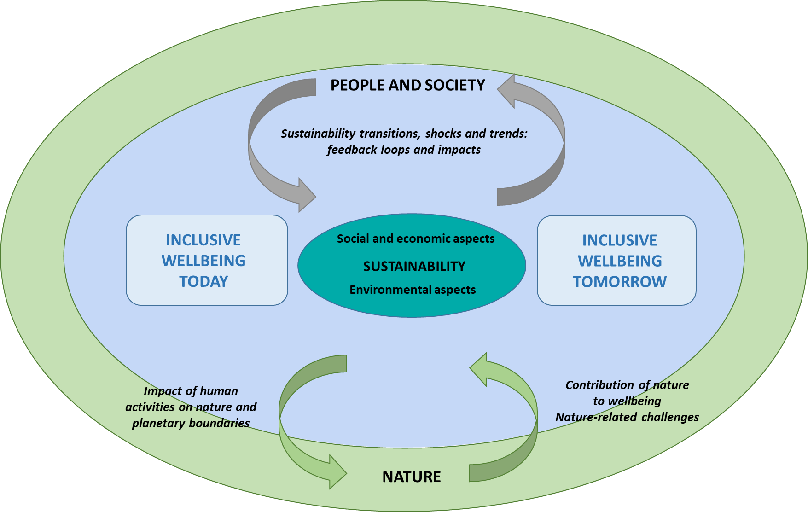
SIWB: a sketch of the conceptual framework

Slide 10
A preliminary mapping of existing tools into SIWB
Also helps the construction of the SIWB dashboard

Slide 11
Work plan: two main work streams and potential additional medium-term activities
Emerging avenues for further work related to the SIWB include:
An expanding scope of GDP adjustments (single monetary value)
A 2-tiered SIWB dashboard
  Medium sized (around 120): a balanced and comprehensive list to assess a country’s progress
  A small headline dashboard (around 20), enabling communication
Developing new indicators (statistical and model-based) to bridge identified gaps (e.g. spillover effects, planetary boundaries; social capital and cohesion)
Developing integrated assessment models (e.g. socioeconomic and environmental) for policymaking, scenario analysis, projections
Using new methodologies to obtain more timely indicators (e.g. nowcasting and short-term forecasting)

Slide 12
A multidimensional approach vs augmented GDP
May be difficult to aggregate across different domains, people or over time
Stiglitz Report (2008): to use “ a limited number of indicators”
Limitations of dashboards: comparability across countries and time, communication
This can be relaxed by composites, but one needs to control the weights
Cannot assess growth, or the monetary returns to investment or other policies
Global health 2035 report (Lancet 2013): health-adjusted income can show the returns to investment in health in a broader and better way
“Those who claim that environmental regulations harm economic growth are completely wrong, because they are using the wrong yardstick.” (Nordhaus 2021)

Slide 13

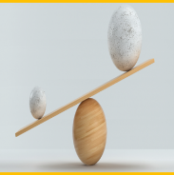
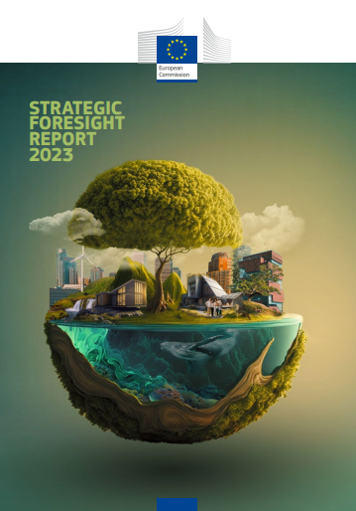

From sustainable and inclusive wellbeing to ‘augment’ GDP
GDP
Assigning monetary values to relevant factors of wellbeing and use these values to “adjust/augment” GDP
Different aspects of quality of life
Unpaid care and domestic work (and others from satellite accounts, like the UK’s GII)
Inequalities
Costs of environmental damage
Natural resource exhaustion
…
SFR 2023 - health
Inequalities
Sustainable and inclusive wellbeing
Environmental damages
…
‘Augment’ GDP/
beyond-GDP metrics

Slide 14
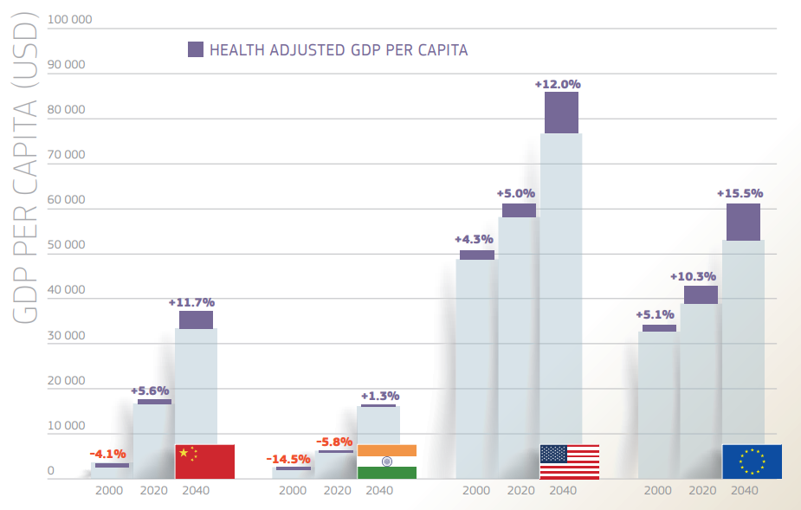
First pilot on beyond-GPD metrics presented in SFR2023
Methodological “deviations from mainstream” due to the projection context:
  Becker et al version of Fleurbeay and Gaulier (survival curves, not life expectancy)
  Reference survival scenario: World 2050

Slide 15

Thank you
JRC-Sustainable-Wellbeing@ec.europa.eu
https://joint-research-centre.ec.europa.eu/scientific-activities-z/resilience_en
© European Union 2024, Slide 2: Columbia University Press, Nobel Foundation archive, rickpilot_2000 (CC BY 2.0), slide 5: Алина Бузунова (from stock.adobe.com), slide 13: Olga Nayda (from unsplash.com), Fotogestoeber (from stock.adobe.com), Landon Parenteau (from unsplash.com)
Unless otherwise noted the reuse of this presentation is authorised under the CC BY 4.0 license. For any use or reproduction of elements that are not owned by the EU, permission may need to be sought directly from the respective right holders.

