Slide 1
Between ideals and realities: challenges in creating societal impact metrics
MERI-Belspo
2024 April 25th
ECOOM Vrije universiteit brussel
Walter Ysebaert – Dirk Derom – Hans Jonker – Padin Fazelian

Slide 2
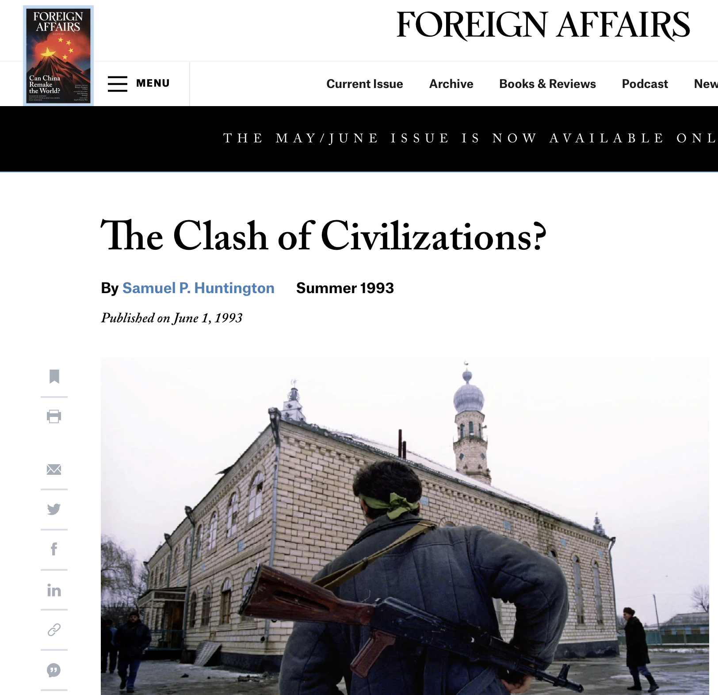
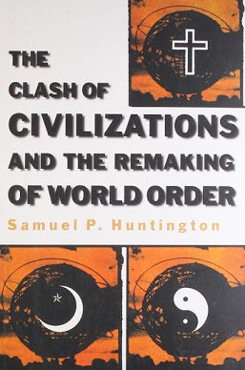
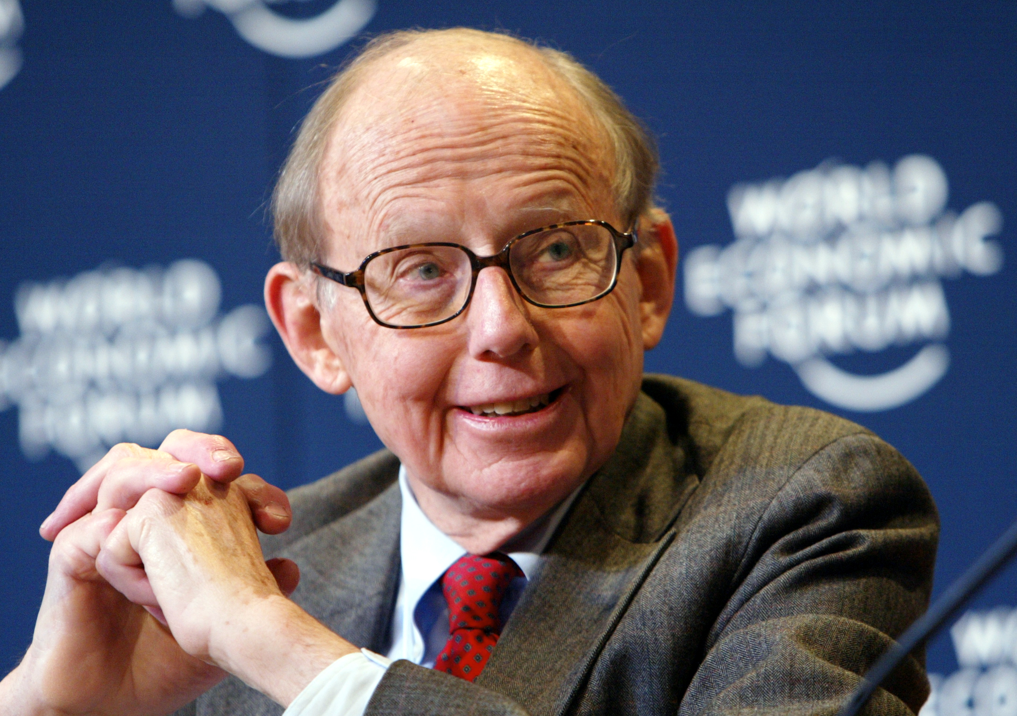
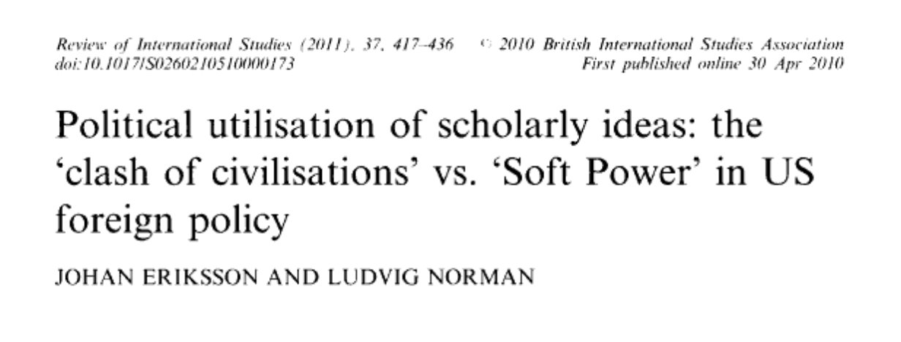
1. Introduction

Slide 3
Can we measure the societal impact of a scholarly essay?
Can we measure the societal impact of research? How?
What is 'societal impact'?

Slide 4
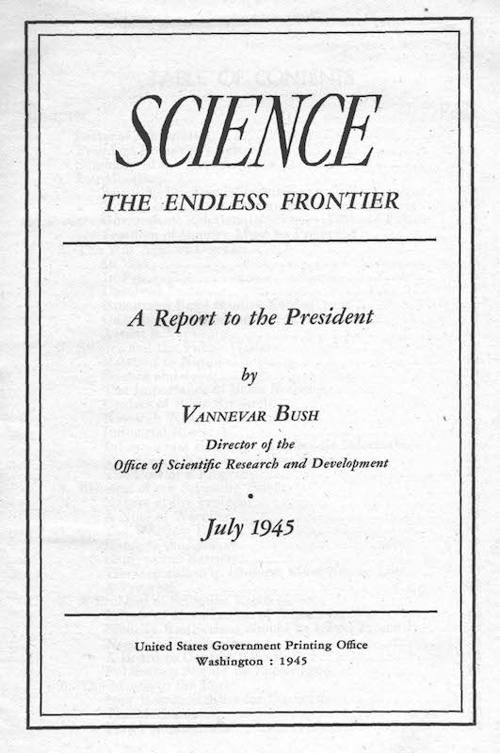
2. Societal IMpact

Slide 5
Evolution since the 80's:
an extensive set of quantitative and qualitative assessment methods and financing models,
a more instrumental approach to research and innovation (and science in general),
a more normative approach to the way in which the scientist engages with the world (and world problems),
introduction of a series of terms and concepts that refer to the societal impact of research.

Slide 6
Policy-relevant research
Knowledge dissemination
Knowledge transfer
Societal engagement
Third mission activities
Research outreach
Research dissemination
Public engagement with science
Research impact assessment
Science communication
Responsible research and innovation (RRI)
Societal relevance
Research valorisation
Research utilization
Societal impact
Social impact
Practise-based research
User-inspired research

Slide 7
“it seems virtually impossible to predict accurately the total social impact of research before it is accomplished”, J.B. Kenrick, 1977
“it is not clear how to evaluate societal quality, especially for basic and strategic research”, van der Meulen & Rip, 2000
“systematic measurements and indicators on impact on the social, cultural, political and organizational dimensions are almost totally absent from literature”, Godin & Doré, 2005
“the assessment of societal impact is badly needed: (…) societal impact is much harder to assess than is scientific impact”, Bornmann, 2013
“SH research makes important societal contributions, but these are not well understood—at least not in the governance of science. We therefore recognize a need to better understand the societal impact of SSH disciplines”, Fecher et al., 2021

Slide 8
Complexities inherent in measuring the impact of research:
attribution problem of research
causality problem
evaluation timescale problem
lack of peer experts
given the variety of disciplines, almost impossible to have single assessment mechanisms and models
institutional contexts
research can have differentiated forms of impact, positive and negative
latency of research impact
unpredictability
...

Slide 9
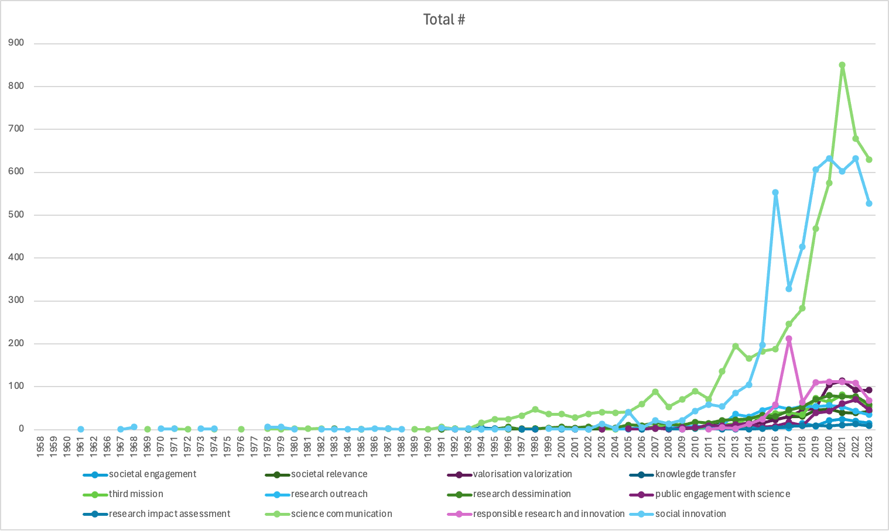
Source: WoS, 15-04-2024

Slide 10
3. Case study – ongoing research ECOOM VUB
Phase 1 (2021-2023)
Media mentions – mentions in policy documents - as proxies for the societal impact of researchers?
Case of Flanders
Databases: FRIS, BelgaPress, Overton
30.226 active researchers (y. 2019)
See:
Jonker H, Vanlee F, Ysebaert W. “Societal impact of university research in the written press: media attention in the context of SIUR and the open science agenda among social scientists in Flanders, Belgium”, Scientometrics. 2022;127(12):7289-7306
Jonker, H. and Vanlee, F., "Linking science with media and policy: the case of academics in Flanders, Belgium", Quantitative Science Studies, forthcoming

Slide 11
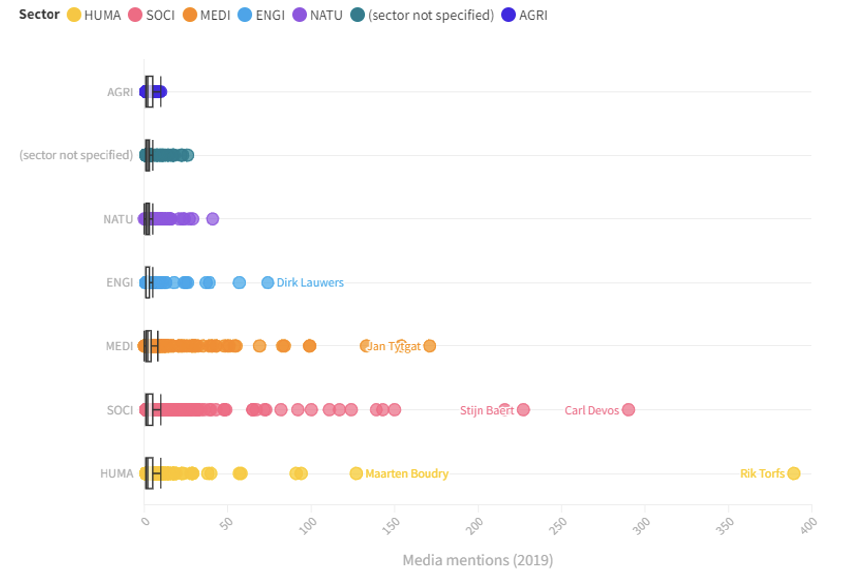
General conclusions:
Only 2451 of 30226 (8.1%) of active academics appeared in the written press once or more
Over-representation of SSH; of male senior academics
Presence of public intellectuals ("celebrities")
Excessive number of mentions are unrelated to research. Only 7.2% of media attention for social scientists went to discussing research. The vast majority of media attention for academics is therefore not about their research in the strict sense.
With regard to policy documents: A small minority (18.0%) of active academics were found in global policy documents. Medical (26.4% active in Flanders vs 40.9% cited in policy) and social scientists (22.6% vs 27.2%) were over-represented in policy documents.

Slide 12
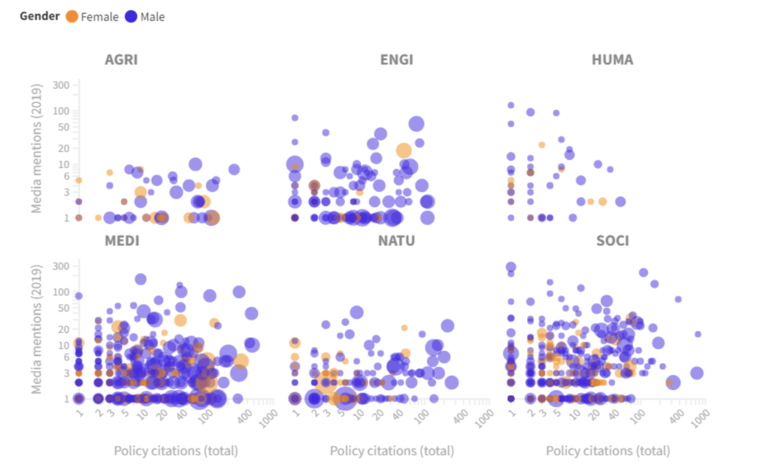
More scientific publications hardly lead to more visibility in the media (>< Anderson et al., 2020; Jensen et al., 2008)
More scientific publications moderately lead to more policy impact. However, the connection between being cited in policy documents and more scientific publications is much more direct compared to media.

Slide 13
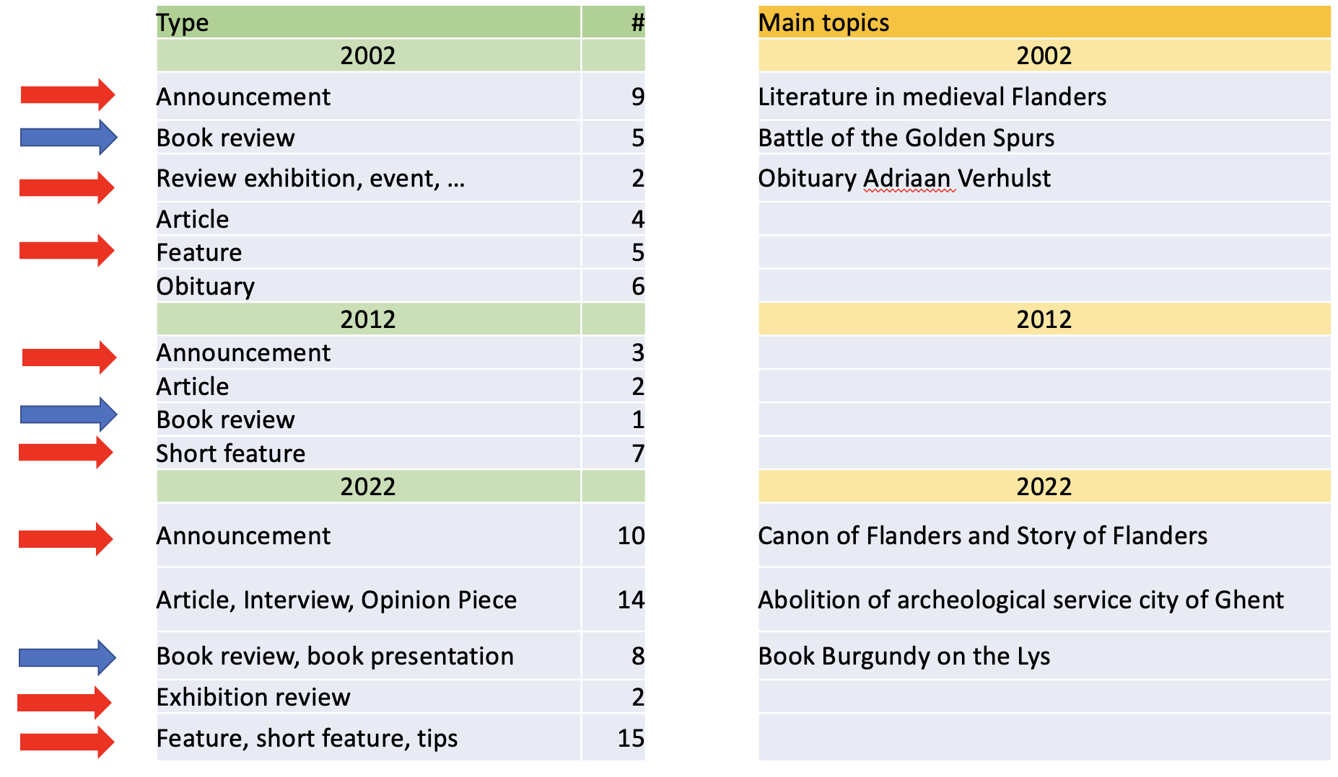
Phase 2 (2023)
Lexicon-based case study: media mentions of Flemish medievalists 2000-2022
Lexicon related to 'medieval history'-research > #6.483 media articles
Close reading y. 2002 / 2012 / 2022 > # 1.068 media articles
Only 93 (8,55%) media articles mention Flemish academic
Only a limited number of media mentions also concern an actual discussion of a historian's research
The media presence of medievalists in Flanders is limited. Media mentions also make only limited references to the research of the academics mentioned.
(publication forthcoming)

Slide 14
Phase 3 (2024)
How to granularly detect and assign mainstream media mentions to specific Flemish researchers and their specific scientific activities?
Phase 1: collecting researchers and research topics from Open Science resources
FRIS: +200K researchers
OpenAlex: Match Research topics
Phase 2: gathering context of mainstream media mentions
Find research names in mainstream media article
Find context of media article: coreference resolution (gather ‘relevant’ sentences)
Assign topic label for the media article using OpenAlex classifier
Phase 3: analyzing and scoring topic proximity
Analyse topic proximity: use topic tree from OpenAlex to ‘calculate’ the distances of the topics
Define ‘relevance’ of mainstream media mentions
Using (novel) computational techniques and Open Science resources (FRIS/OpenAlex), contextual information on research media mentions can be detected, assigned and weighted.

Slide 15
4. Navigating the Complexities of Societal Impact Assessment: Towards a Balanced and Critical Approach
No absolutely normative approach regarding generating societal impact + move beyond "societal impact" (> conceptual clarification).
Absolute necessity of open science, open sources, open data, open 'grey literature'.
Absolute need for more contextual qualitative research.

Slide 16
Thank you.

